Slide 1
Chinook Trail Association
March 21, 2021
Indian Creek Trail – Hood River
Historic Columbia River Highway State Trail – Hood River & Mosier
The Dalles Riverfront Trail – The Dalles
Weldon Wagon Trail – Husum/White Salmon
Presented by Steve Jones
Notes:
Welcome

Slide 2
Indian Creek Trail – Hood River
Indian Creek Trail 5 Miles
Trailhead elevation is 215 feet
Elevation gain 560 feet and loss of 85 feet
No fees or permits for parking
Restrooms at Hood River Trailhead
Drivetime from Vancouver is about 70 minutes
Notes:
This first section is an old trail connecting the upper and lower parts of the city. A pipeline diverted water from Indian Creek for a fruit cannery in downtown Hood River. There were water-powered refrigeration units that cooled entire buildings for fruit storage and made blocks of ice for the railcars that carried the fruit across the country.

Slide 3
Notes:
The trail climbs moderately through a forest of big-leaf maple and oak trees for about 0.5 mile then levels off

Slide 4
Notes:
There are some nice views of Hood River

Slide 5
Notes:
You can see Highway 35 across the Hood River Valley.

Slide 6
Notes:
This wood-stave pipeline is broken in several places and no longer works. Impressive that is looks this good after 100 years.

Slide 7
Notes:
One section has a boardwalk over a wet section of trail. This is just before the start of a ¾ mile section where you road walk to the Indian Creek Golf Course to rejoin the trail

Slide 8
Notes:
The trail continues along Indian Creek through Barrett Park to Barrett Drive

Slide 9
Historic Columbia River Highway State Trail – Hood River & Mosier
Hood River – Mosier Trail 4.8 Miles
Trailhead elevation is 345 feet
Elevation gain 440 feet and loss of 570 feet
Oregon State Park Permit required: $5 for day, $30 for 12 months, $50 for 24 months.
Restrooms at Hood River and Mosier. Note: Moiser restrooms currently closed
Drivetime from Vancouver is about 70 minutes
Notes:
You can buy a day pass at the parking lot. The little gift shop is closed because of Covid but the bathrooms are open.
Parking fees are five dollars for a day three dollars for a 12 month Oregon park permit $50 for a 24 month parking permit or a current Oregon state park camping receipt.
The western parking lot has room for about 50 cars. The eastern parking area has room for about 40 cars and is about a 10th of a mile up the old Columbia River highway from where the trail meets the highway.

Slide 10
Notes:
The trail is the old scenic Highway 30 so it is quite wide.

Slide 11
Notes:
A nearby viewpoint provides a nice view of the Hood River Bridge.

Slide 12
Notes:
The trail winds gently down to a small seasonal waterfall next to a nice picnic table.

Slide 13
Grass Widow, Olsynium douglasii
Notes:
Grass Widows are in the Iris family
This native plant grows in western US and western Canada

Slide 15
Notes:
After about 4 miles you come to the Mosier twin tunnels.
When the original Columbia River Highway (CRH) was built through this area in 1921, it was necessary to build two tunnels to get through a high rock point. Construction of the tunnels took two years. They were originally 17 feet wide but later because of traffic accidents were white to 20 feet. These tunnels and the nearby cliffs were a troublesome spot on the CRH: rockfalls were common and accidents happened all too frequently. A new road was completed in 1954 near water level and the tunnels were abandoned. They were soon filled with rock rubble and forgotten.

Slide 16
Notes:
The western tunnel entrance is now protected by a concrete structure that prevents rocks from falling on the trail.

Slide 17
Notes:
In about 3 miles and after passing through the tunnels you come out to a path leading to a lovely viewpoint that was built in 2000. From here there are more panoramic views of the gorge.

Slide 18
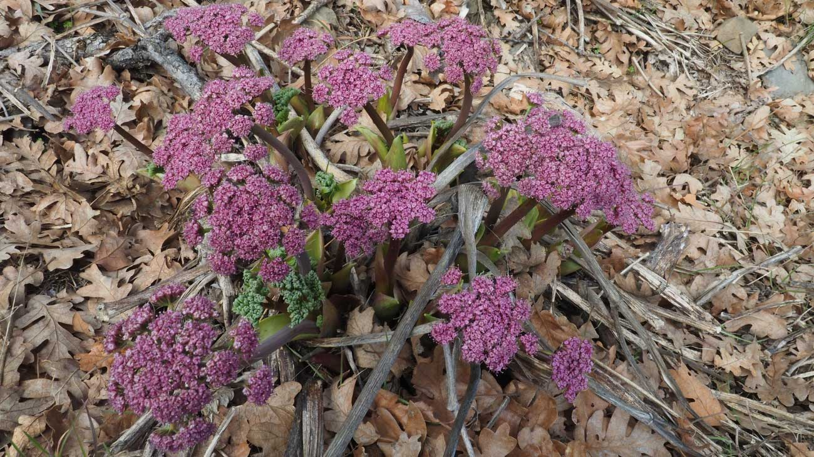
Columbia Parsley, Lomatium columbianum
Notes:
Soil wetted by winter rain and snow allows wildflowers to bloom in early spring. Hood River gets about 31 inches of precipitation per year.

Slide 19
Notes:
The eastern end of the trail goes through basalt rubble where trees and brush find difficulty growing.

Slide 20
The Dalles Riverfront Trail – The Dalles
The Dalles Riverfront Trail 6.3 Miles
Trailhead elevation is 90 feet
Elevation gain 135 feet and loss of 10 feet
No fees or permits for parking
Restrooms at the marina
Drivetime from Vancouver is about 90 minutes
Notes:
Parking is free at the marina but part of the parking lot is closed from November 1 to the memorial day weekend.

Slide 21
Notes:
From the marina head west and then about a mile you come to the historic site of rock fort camp and was picked because it was the first place they saw trees coming from the eastern area. They stayed here for three days hunting before moving on.

Slide 22
Notes:
You skirt an industrial area where the trail is sandwiched between the freeway and the river.

Slide 23
Notes:
After 4 miles you make a dogleg and crossover Chenoweth Creek. Cottonwoods grow along the banks of the creek.

Slide 24
Notes:
There is an industrial area along the river. This is the Google complex.

Slide 25
Notes:
There are nice view across the river to the Washington side.

Slide 26
Notes:
The Columbia River is a marine highway and frequently has tugboats pushing barges up and down the river.

Slide 27
Notes:
There are a few spring wildflowers along the river but for the most part it is mostly grass, rock, and brush.

Slide 28
Notes:
Near the far end is a tunnel underneath the railroad tracks. This tunnel was built by freezing the soil above the future tunnel then excavating and pushing the pipe casing of the tunnel through the railroad fill underneath the track. There is a sign just past the tunnel the detailing its construction.

Slide 29
Notes:
Climb a hill to reach the Dallas discovery center which is a very nice museum and worth a separate visit. You can walk around the pond at the west end of the discovery center and then as you come back you can pass by the main entrance. If the stream is running you’ll notice that it’s narrow at the top and wider at the bottom. This is in proportion to the amount of rainfall that falls in the Dalles at the top versus the amount of rainfall that falls in Portland at the bottom. Portland gets about 43 inches of precipitation and The Dalles gets about 18 inches of precipitation each year.

Slide 32
Weldon Wagon Trail – Husum/White Salmon
Weldon Wagon Trail 2.3 Miles
Trailhead elevation is 670 feet
Elevation gain 1,200 feet and loss of 30 feet
No fees or permits for parking
Closest restrooms at Husum
Drivetime from Vancouver is about 90 minutes
Notes:
Built in the early 1900's to transport apples from the upper farmlands to the White Salmon River for transport to markets.

Slide 33
Notes:
Go past the chained gate and walk up the gravel road.

Slide 34
Notes:
There are nice views of Mt. Hood in the distance to the south and Augspurger Mountain towards the west.

Slide 35
Notes:
The trail climbs gently and soon rises above the forest floor. Here the trees change abruptly from pine and fir to white oaks. The underbrush thins and the views open up between the trees. The white oaks vary in size from youngsters to stocky trees that are over 100 years old.

Slide 36
Notes:
Deer brush (Latin Name: Ceanothus integerrimus), a woody shrub is native to the western United States in Arizona, New Mexico, California, Oregon, and Washington

Slide 37
Notes:
The trail crosses a DNR 551 acre natural resources conservation area for Oregon white oak.

Slide 38
Notes:
The trail cuts across the open slopes above Indian Creek

Slide 39
Notes:
Lots of worms

Slide 40
Notes:
The wagon trail leaves the forest and heads down a grassy track along a tree farm and past some rusting farm equipment to the Sanborn Road Trailhead. Seeing the old farm equipment makes you think about the past and how technology has changed farming.

Slide 41
How You Can Get Involved
Come hike!
Talk about the Chinook Trail with your friends, acquaintances, and social media
Clear trail and participate on trail maintenance crews
Continue to be a member
Become a board member
Notes:
www.chinooktrails.org

Slide 42
Questions?
Steve Jones
Chinook Trail Association

