Slide 1
Chinook Trail Association
March 27, 2022
Agenda
Silver Star Area Barrier Breaches
4109 Trailhead Silver Star Trailhead
DNR L-1180/L-1182 Roads
New Hiking Trails
Appaloosa Trail
Sword Fern Way
Social Media Postings
Conclusion and Questions
Presented by Steve Jones
Notes:
Welcome
Thank our members for your support of the Chinook Trail Association

Slide 2
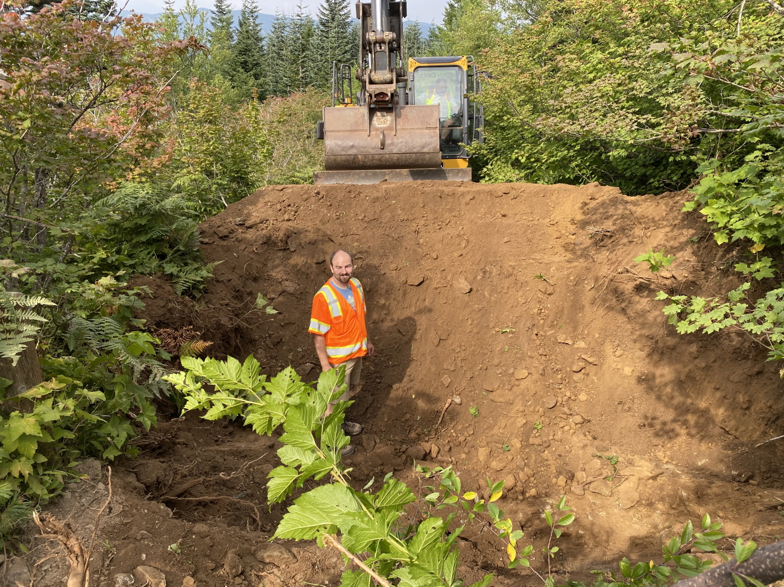
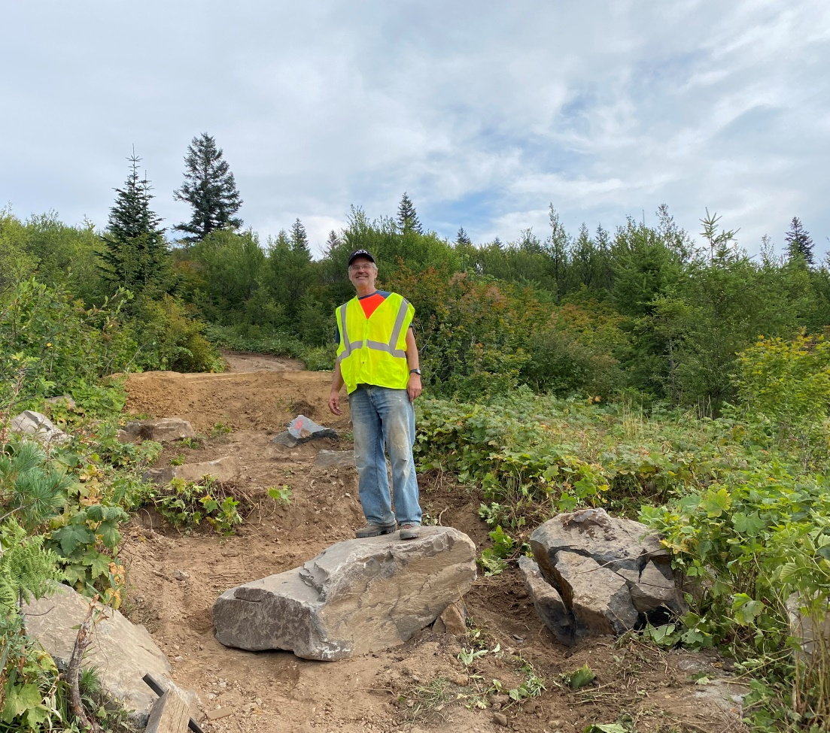
Silver Star Area Barrier Breaches
Ditches dug above the Forest Road 4109 Silver Star Trail Parking Lot
Notes:
Jeremy and Steve near the Silver Star Trailhead.

Slide 3
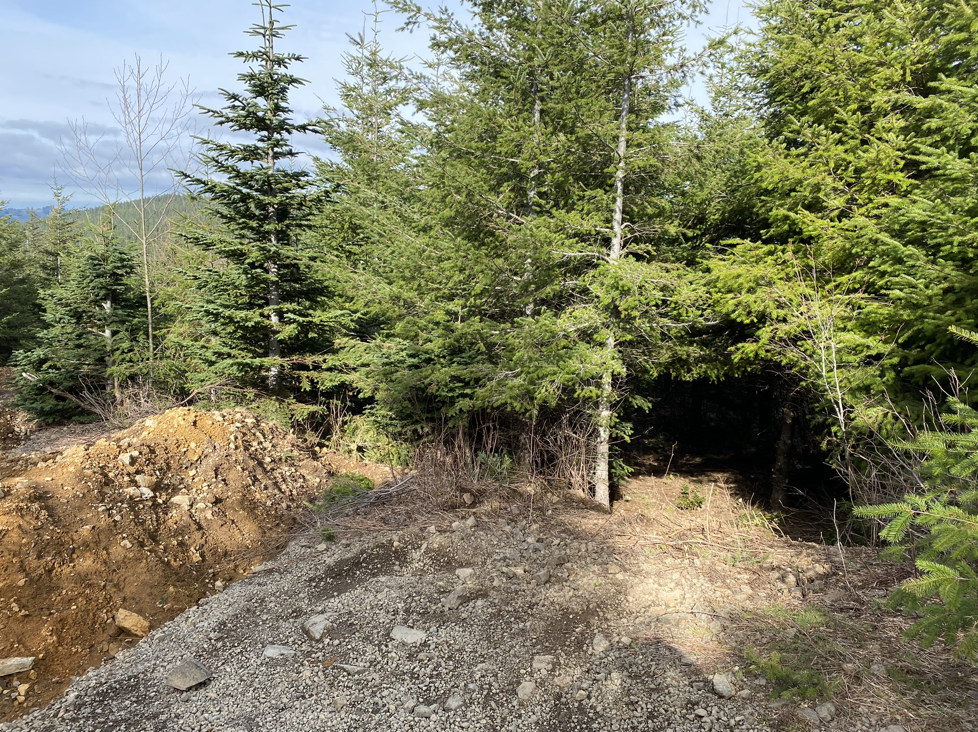
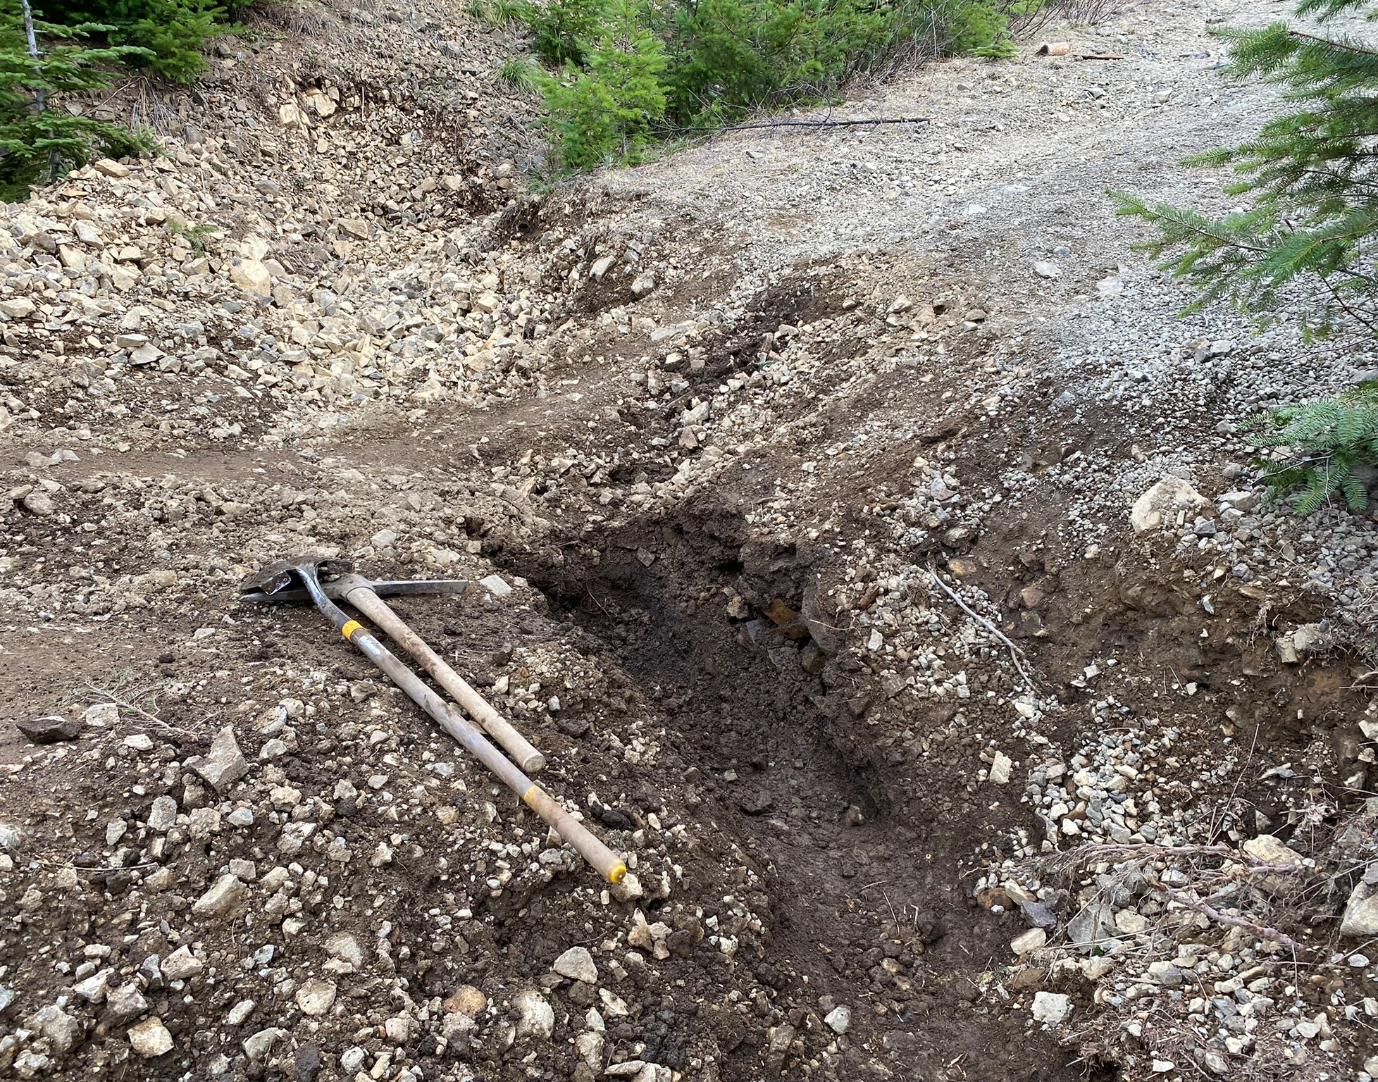
Ditches Dug at DNR L-1182/L-1182 Road Leading to Jeep Road That Crosses The Chinook Trail
Notes:
Off roaders have cut down trees to bypass the lower barriers.

Slide 4
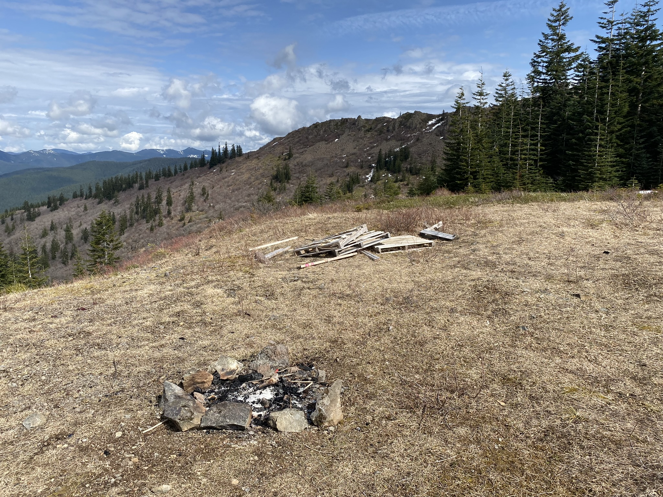
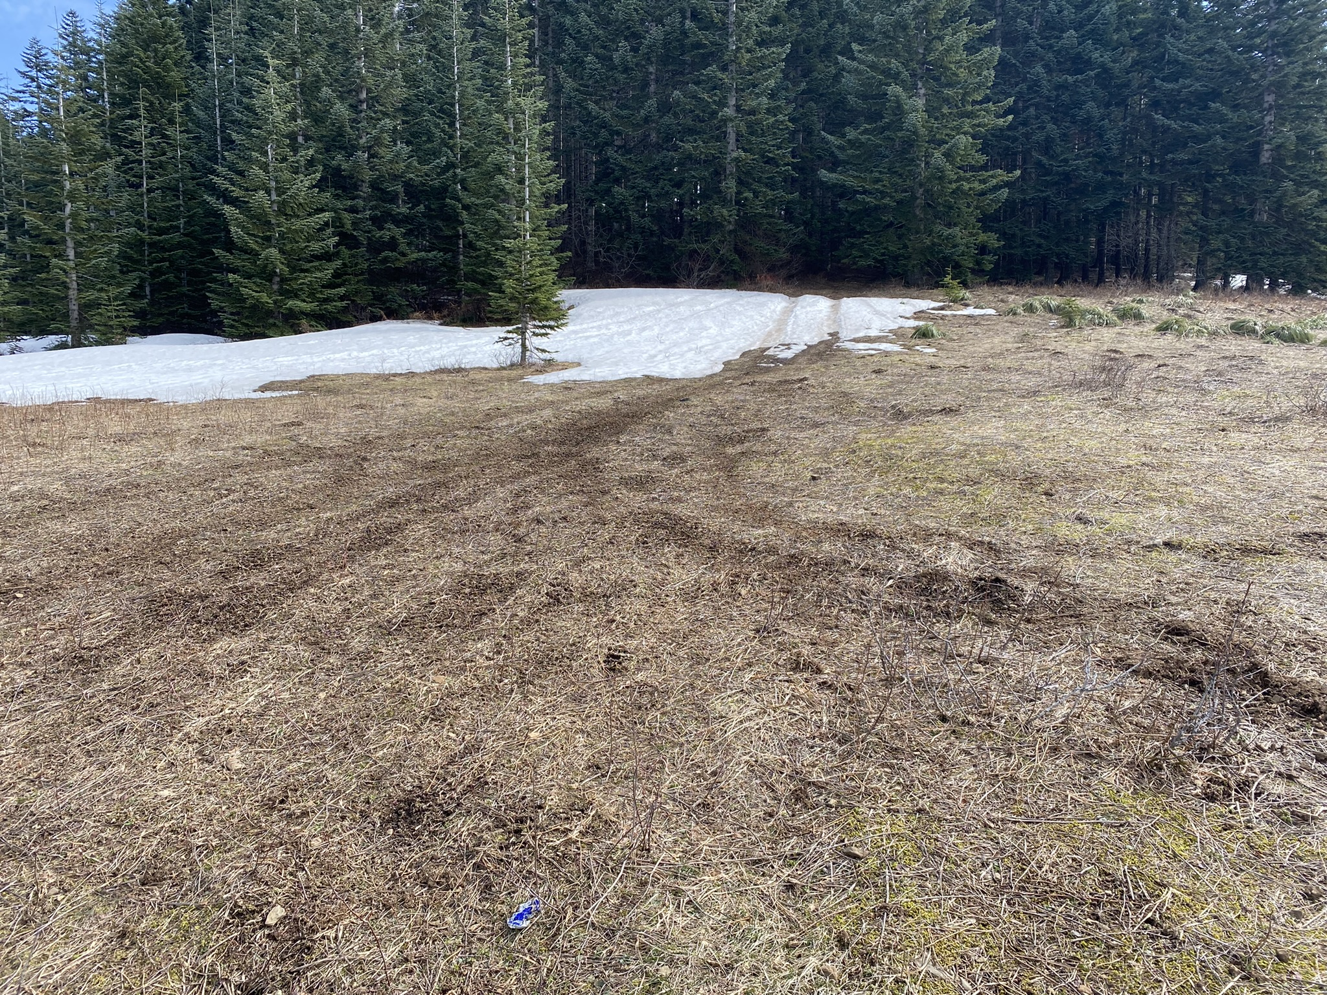
Meadow Damage
Notes:
Pictures taken March 2022

Slide 5
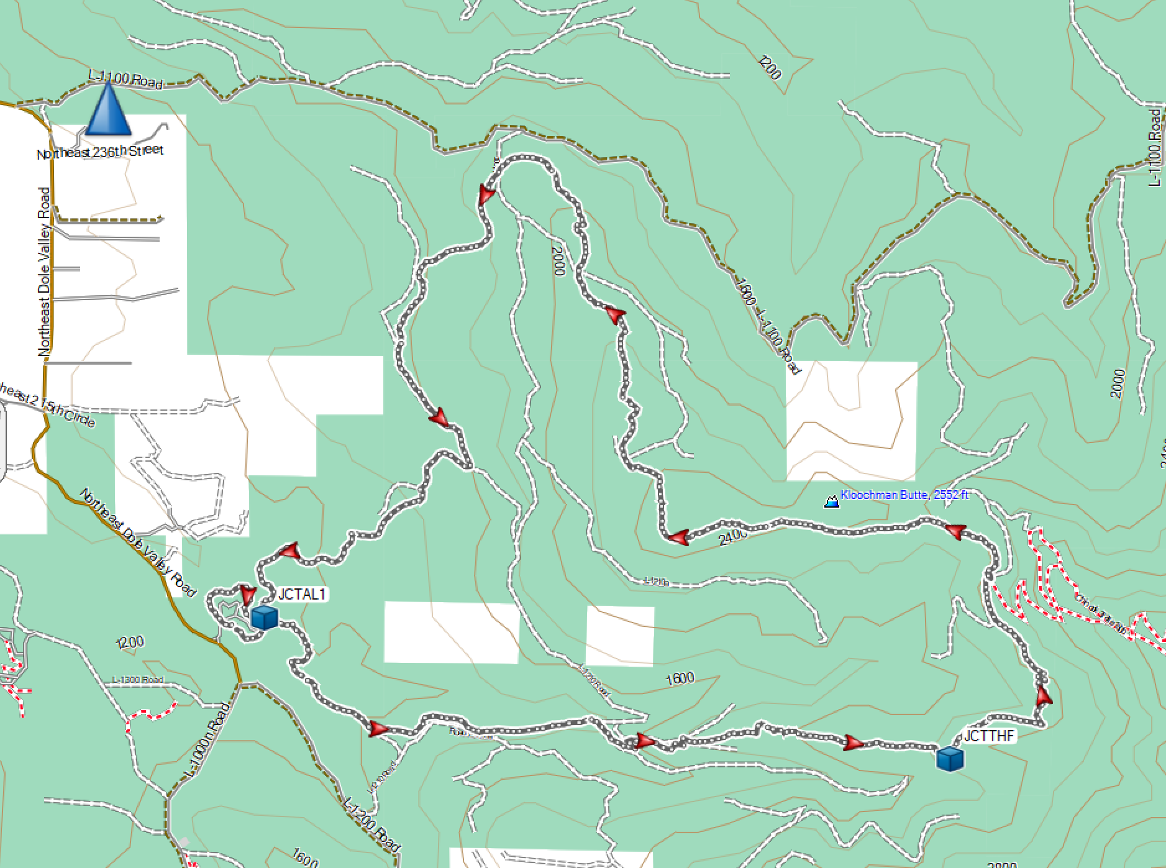
Appaloosa Trail
Appaloosa Trail 3.5 Miles
Trailhead elevation is 1,063 feet
Elevation gain 1,469 feet and loss of 260 feet
Tarbell Trail 8 Miles
Elevation gain 1,123 feet and loss of 2,319 feet
Washington Discover Permit required: $11.50 for day, $35 for 12 months.
Restrooms at Rock Creek Campground
Drivetime from Vancouver is about 45 minutes
Notes:
17 Mile Trail Initiative
About 15 years ago DNR started The 17-mile non-motorized trail project increasing hiking opportunities on the Tarbell and Bells Mountain Trail system. DNR provided a map with proposing several new trails in the northern section of the Yacolt Burn. These trails were just numbers at the beginning of the initiative. 1 - Sword Fern Way, 2 - Spotted Deer Mountain, 3 – Appaloosa, 4 - Silver Shadow. Appaloosa there were some old trails in the area. Bridge across Coyote Creek. Citizens were involved and had meetings once a month for trail inputs.
Tom Griffith with WTA/CTA worked on Sword Fern Way several times.

Slide 6
Notes:
Rock Creek from the hiker/equestrian bridge just out of the Rock Creek Campground.

Slide 7
Notes:
The trail is fairly level to this bridge over Coyote Creek then begins climbing.

Slide 8
Notes:
Territorial views from one of the gravel road sections.

Slide 9
Notes:
It looks like this section of the Tarbell Trail will be closed through April 2022.

Slide 10
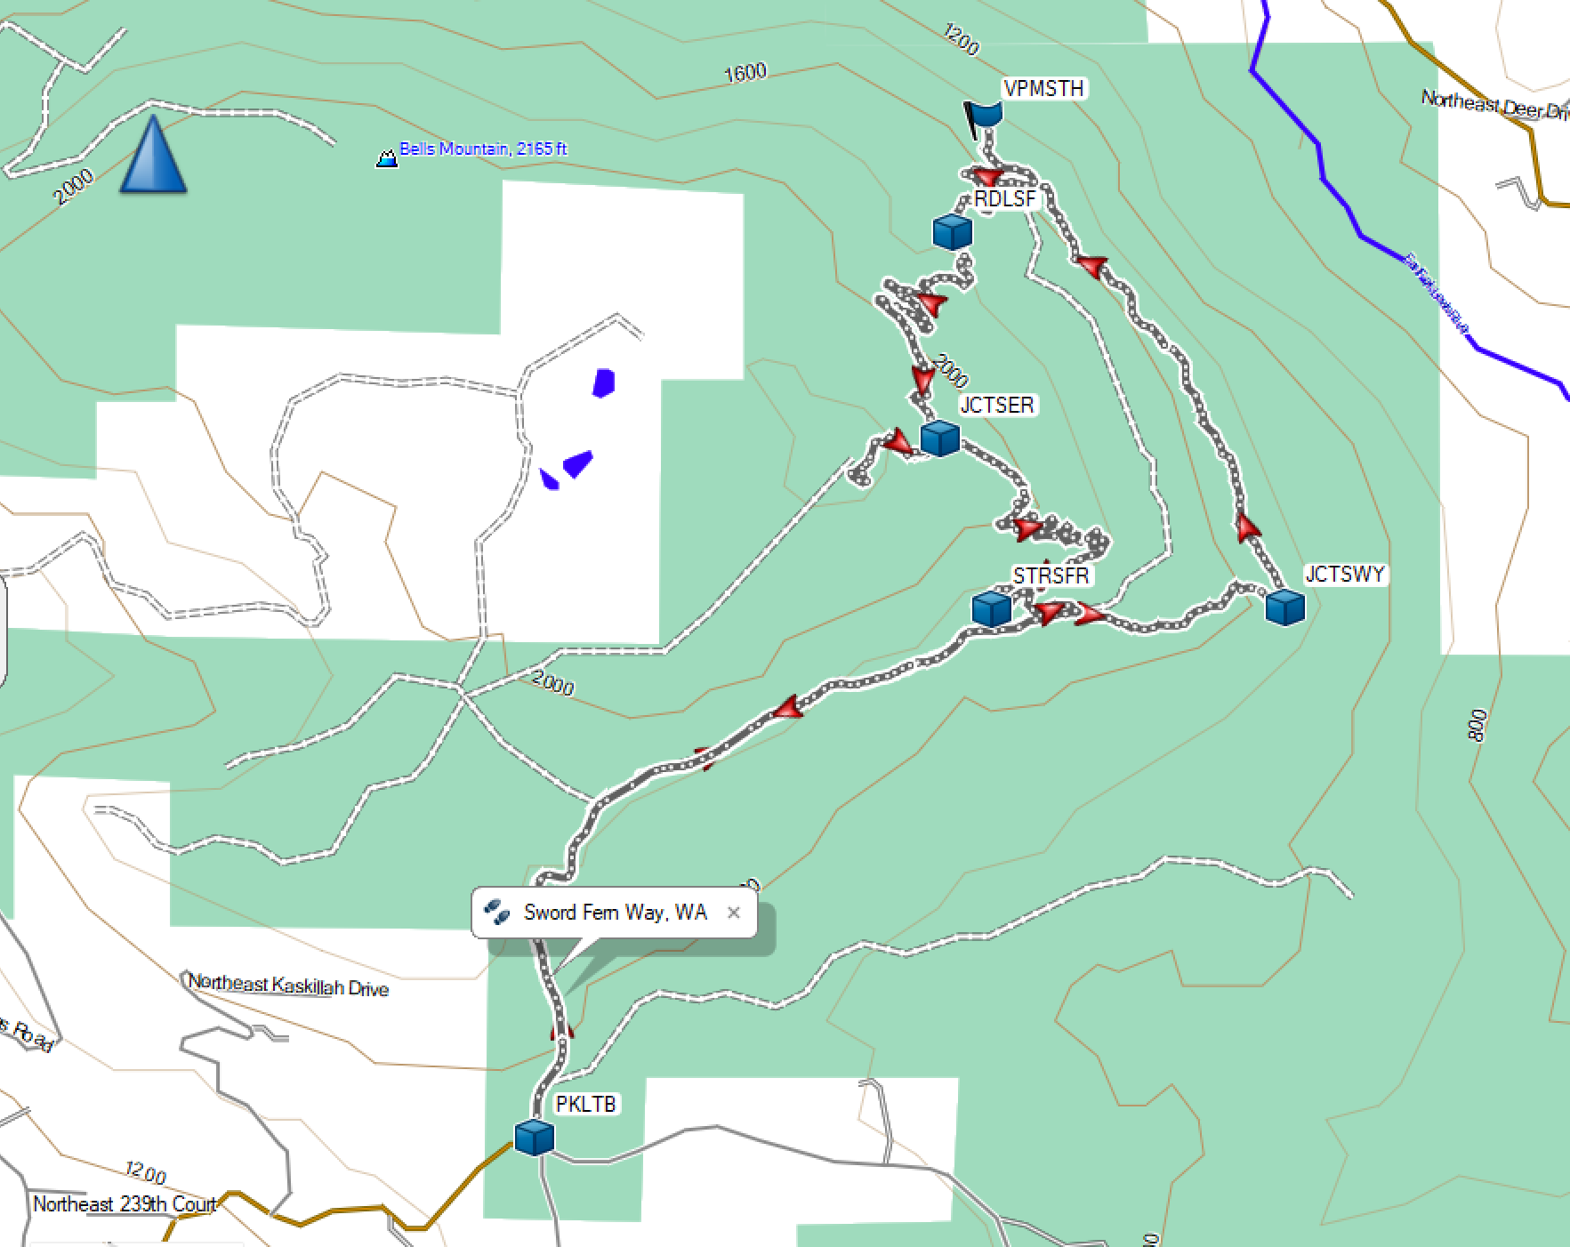
Sword Fern Way
Sword Fern Way Trail 3.5 Miles
Bells Mountain section 1.3 Miles
1.5 mile walk each way on NE Berry Road to each way to access the trail with a total elevation gain of about 730 feet.
Accessed from NE Kaskillah Dr & NE Berry Rd. Trailhead elevation is 1,730 feet
Elevation gain 1,100 feet and loss of 1,100 feet
Washington Discover Permit required: $11.50 for day, $35 for 12 months.
No restrooms
Drivetime from Vancouver is about 35 minutes
Notes:
Sword Fern Way can also be accessed from Moulton Falls. It is about 2 miles each way and 2,200 feet of total elevation gain

Slide 11
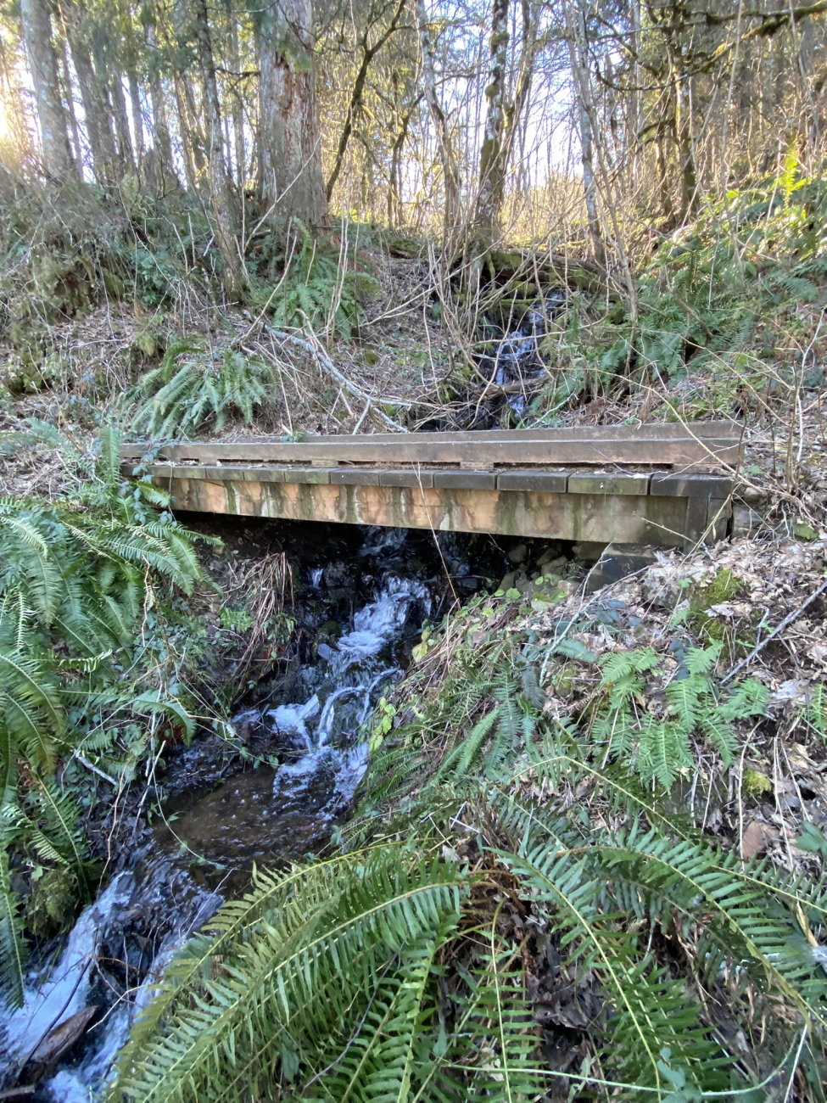
Notes:
Sword Fern Way connects to Bells Mountain Trail from the logging road. Bells Mountain Trail crosses several streams on bridges built by the Chinook Trail Association.

Slide 12
Notes:
Walking a little farther along Bells Mountain Trail provides this view of Mt. St. Helens.

Slide 13
Notes:
Taking the path to the communications tower leads to this clear-cut with a view of Mt. Hood.

Slide 14
Social Media Postings
Facebook
Twitter
Instagram
Newsletter, Website, and Emails
Three Newsletters Each Year
Website & Resources
Email List For Events
Volunteer Page
sjones@chinooktrails.org

Slide 15
How You Can Get More Involved
Come hike!
Talk about the Chinook Trail with your friends, acquaintances, and social media
Clear trails and participate on work parties
Continue to be a member or join Chinook Trail Association
Become a board member
Notes:
www.chinooktrails.org

Slide 16
Questions?
Steve Jones
Chinook Trail Association

Slide 17
Notes:
Thank you.

