Slide 1
Chinook Trail Association
2024 Annual Celebration

Slide 2
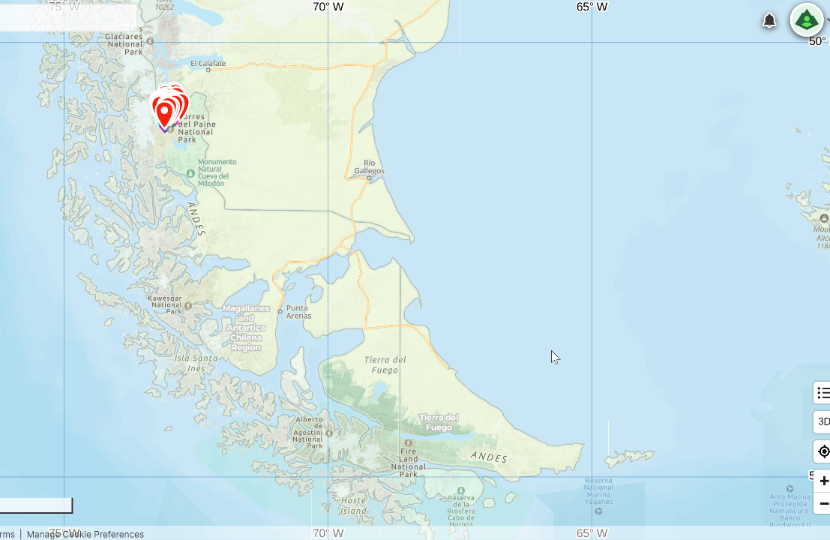

Slide 3
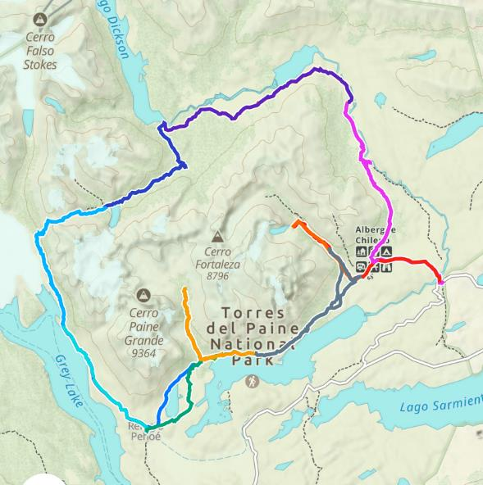
Patagonia O-Circuit
Includes the W-Circuit
83 Miles in 9 Days
27,000 feet gain and loss
3,900 foot highest elevation
50 to 60 mph gusts
Only counterclockwise permitted
First hiked in 1976
Notes:
Logistics
Pre-planning
Meetings, permit opening dates, reservations
Travel packages available
Travel
Customs
Taxi met us at airport
Punta Arenas, Puerto Natales, Los Torres del Paine
Supplies
No fuel on airplanes
Possible foods not allowed

Slide 4
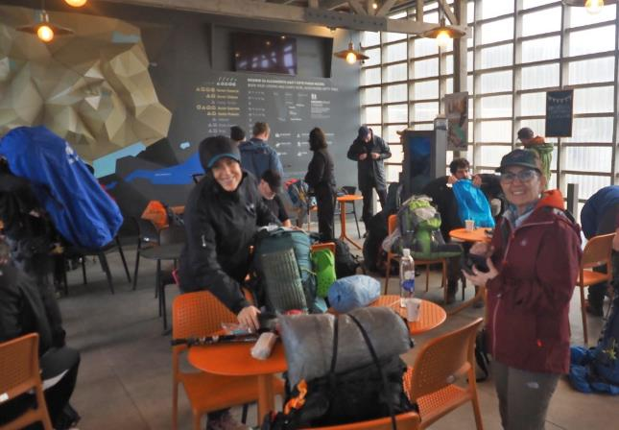
Day 1 - 10 miles 1,025 elevation gain and 925 loss in 5 hours.
Las Torres Welcome Center to Serón
Notes:
Day 1 Las Torres Welcome Center to Serón
Confusing finding out where to go next
Easy trail but not many mountains

Slide 9
Day 2 - 11.6 miles 1,011 elevation gain and 882 loss in 7.5 hours.
Serón to Dickson
Notes:
Day 2 Serón to Dickson
First good glacier views along Lago Paine
Trees has mosquitoes
Nice walk along gravel lakeshore of Lago Dickson
Views of Dickson Glacier

Slide 16
Day 3 - 7.9 miles 1,400 elevation gain and 251 loss in 6.5 hours.
Dickson to Los Perros
Notes:
Day 3 Dickson to Los Perros
Starting to get windy

Slide 23
Day 4 - 9.9 miles 2,392 elevation gain and 4,043 loss in 11 hours.
Los Perros to Grey
Notes:
Day 4 Los Perros to Grey
Hardest stage of the O-circuit. Set out before sunrise. Check forecast before ascending to John Gardner Pass.
Postpone if weather forecast is bad.
View of Grey glacier, Grey Lake, and 3 suspension bridges

Slide 31
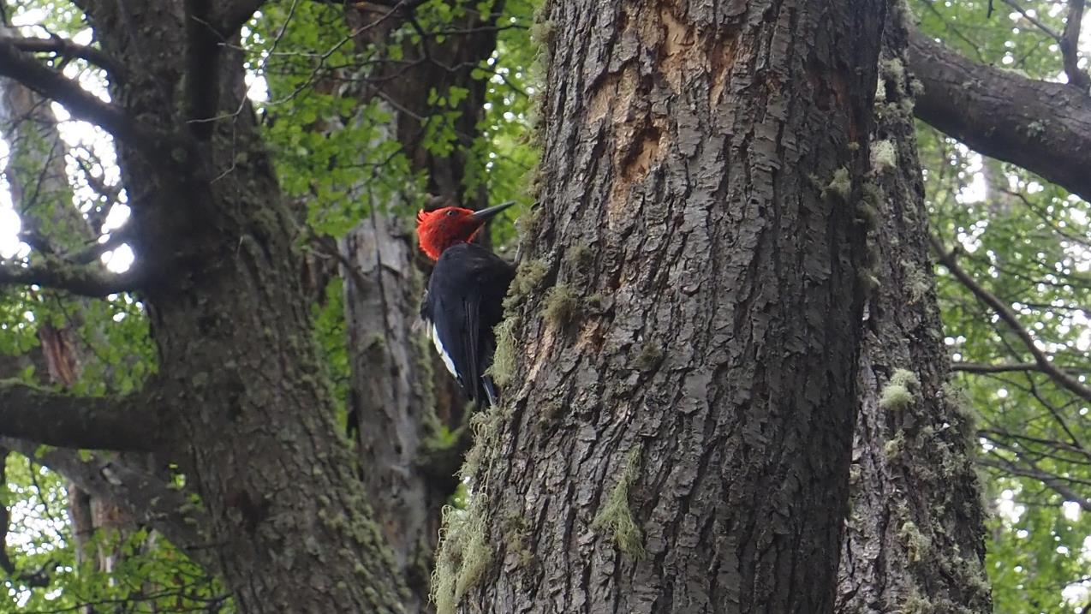

Slide 35
Day 5 - 6.8 miles 1,154 elevation gain and loss in 5 hours.
Grey to Paine Grande
Notes:
Day 5 Grey to Paine Grande
Where O-circuit meets W-trek (expect crowds)
Turquois water of Lago Pehoe
Views of Cerro Paine Grande

Slide 42
Day 6 - 6.2 miles 1,060 elevation gain and 631 loss in 5 hours.
Paine Grande to Frances
Notes:
Day 6 Paine Grande to Frances
Took the long way
Walked along Lago Nordenskojd
Platform camping on steep hillside

Slide 46
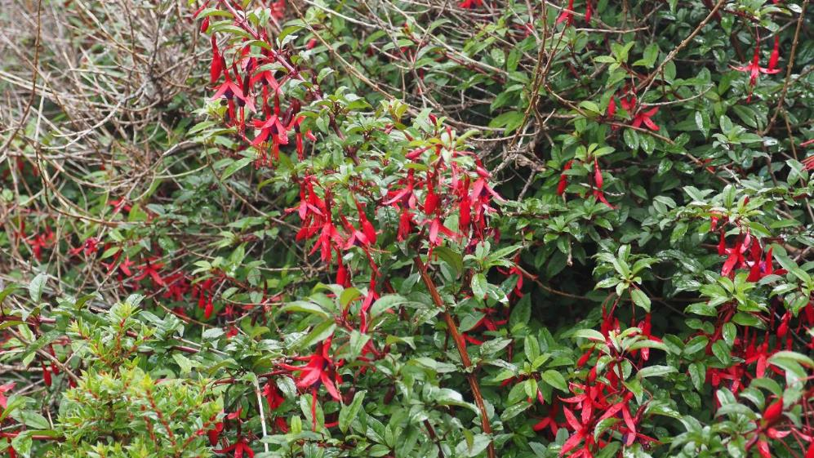
Day 7 - 11.7 miles 2,325 elevation gain and 2,639 loss in 9.5 hours.
Frances to Los Cuernos
Notes:
Day 7 Frances to Los Cuernos
Start with day hike up to Mirador del Frances, Valle del Frances, and Britanico
Ice falls about every 10 to 15 minutes

Slide 53
Day 8 - 11.1 miles 2,165 elevation gain and 1,121 loss in 7 hours.
Los Cuernos to Chileno
Notes:
Day 8 Los Cuernos to Chileno
Got onto the wrong trail
A constant slog up to the camp
Everything is packed in and out on horses
Platform camping near a roaring river
No cooking allowed
Could only reserve on platform and one pre-set tent

Slide 54
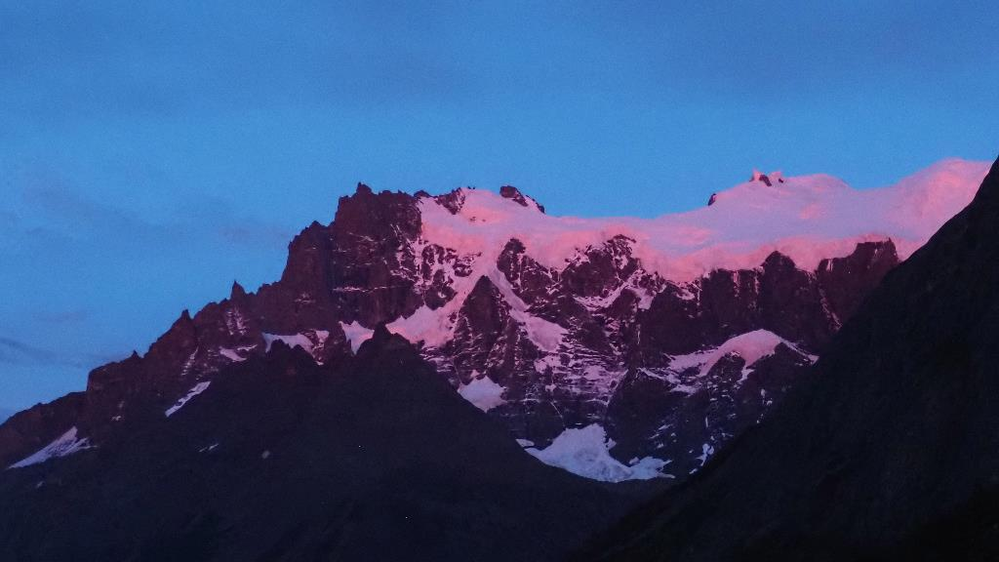

Slide 65
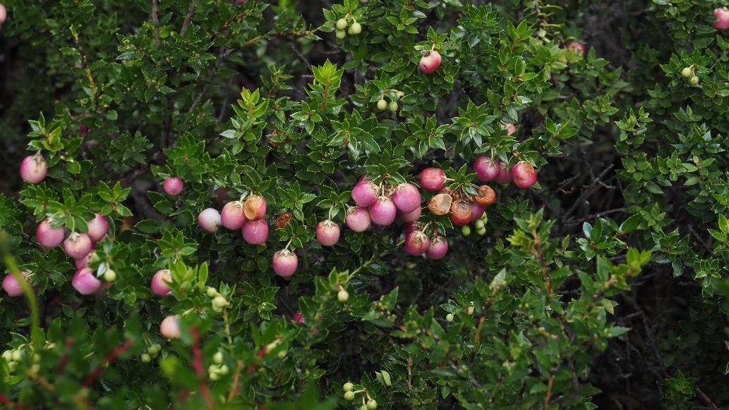
Day 9 - 7.7 miles 951 elevation gain and 2,802 loss in 8 hours.
Chileno to Central Mountain Hostel
Notes:
Day 9 Chileno to Central Mountain Hostel
Early breakfast
Second hardest stage of the O-circuit.
Awake at 3:30 am to make it to Mirador Base Las Torres by sunrise.
Some sections almost a scramble
Lots of people
Chileno reserves fast. Many people start from El Centro at midnight for sunrise

Slide 67
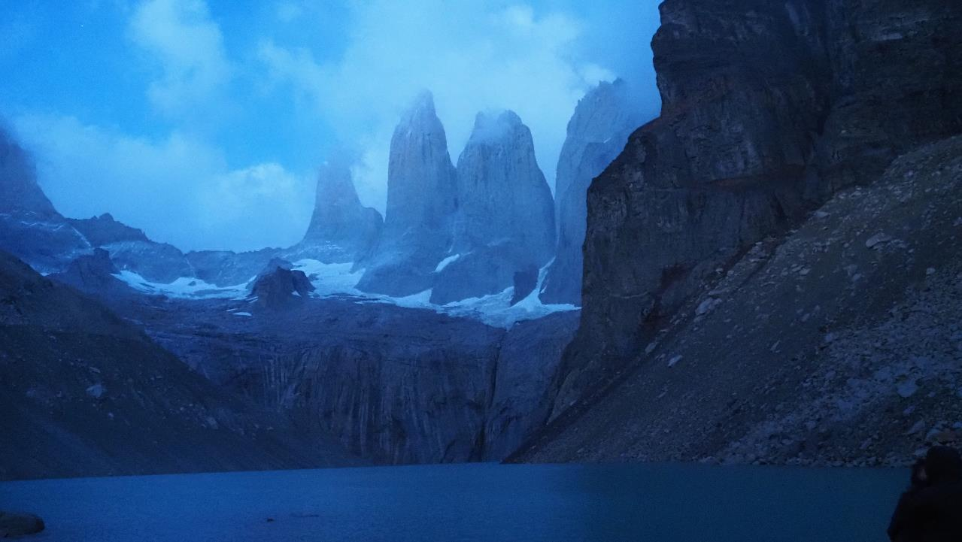

Slide 77
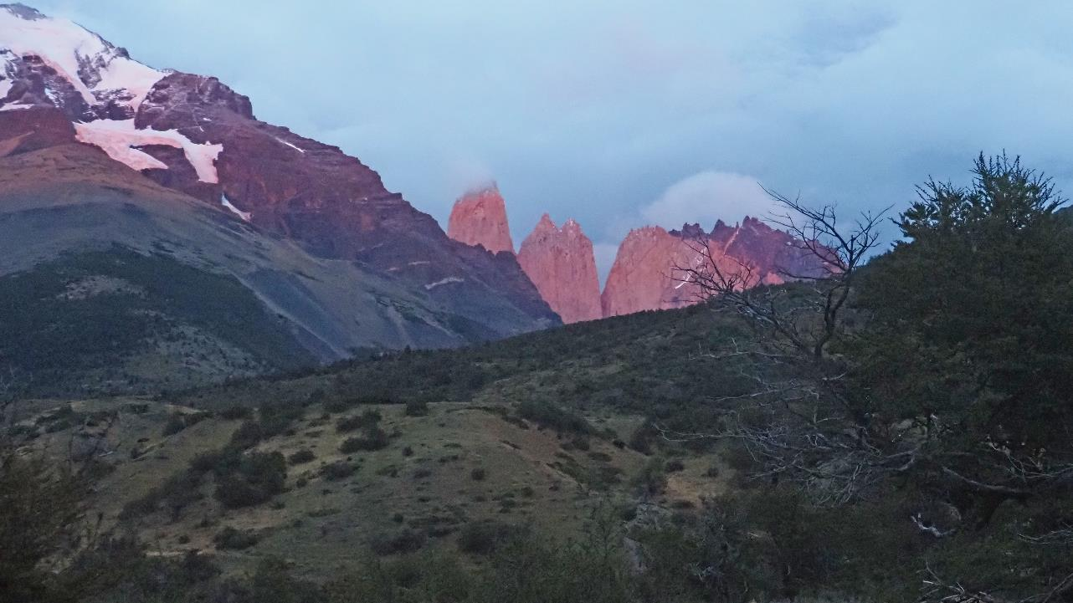

Slide 79
Day 10 – Bus in the park, bus to Puerto Natales.
windguru.com

Slide 81
Questions?

