Slide 1
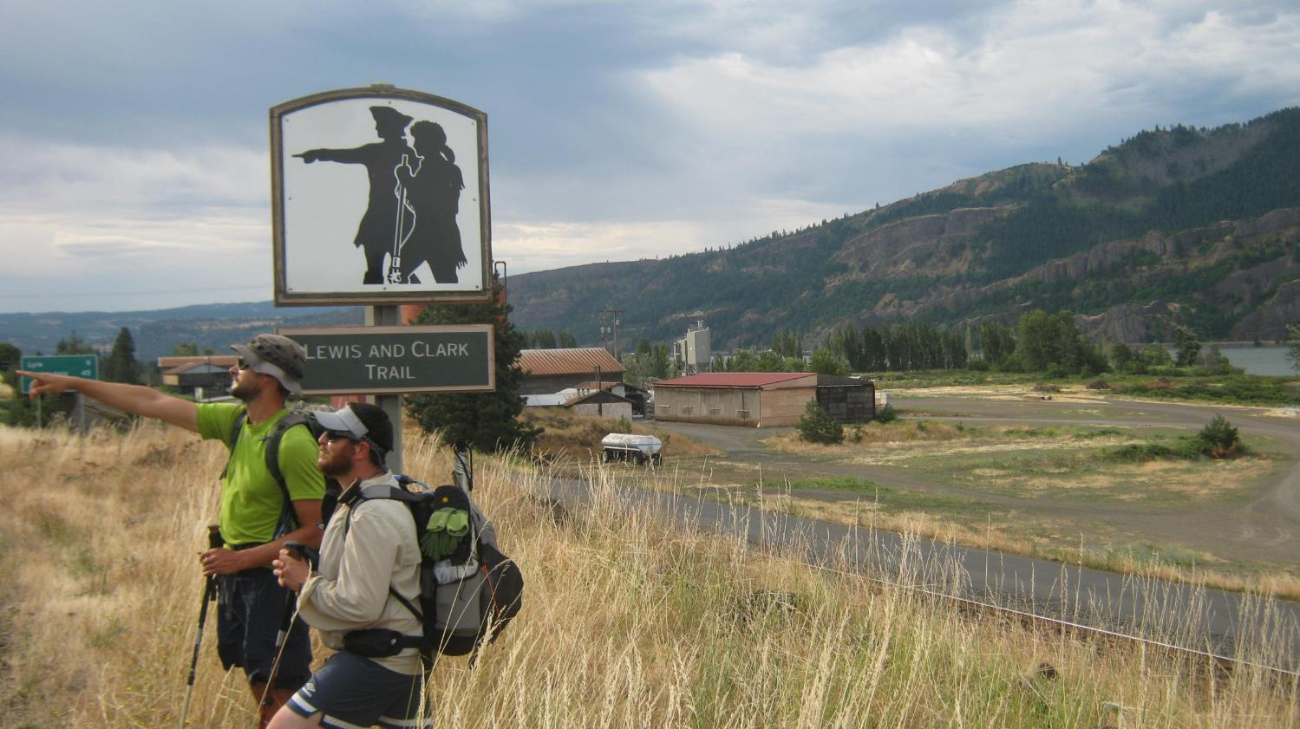
The Chinook Trail
Presented by “ALLGOOD”
Whitney LaRuffa

Slide 2
About Us
Allgood-AT, AT Ridge Runner, AHT, JMT, WT, TRT& Chinook Trail
Tomato-Triple Crowner, PCT, JMT, PNT, ODT, Chinook Trail
Snorkel-Triple Crowner, JMT, Inmann 300, TRT, FKT Unsupported Woman AT

Slide 3
ALDHA-West
American Long Distance Hiker Association-West
Founded in 1993
Mission: To promote fellowship and communication among long distance hikers, and those who support long distance hiking
Annual Gathering the last weekend of September annually
Presentations and forums on long-distance hiking

Slide 4
History of The Trail
The concept of the Chinook Trail originated in 1986 with two lifelong hiking companions, Don Cannard and Ed RobertsonStanding on the summit of Silver Star, a 4400 foot peak noted for its glorious wildflower displays, they dreamed of a trail going through the Columbia River Gorge. Originally, the trail was only going to go through Washington, but then the Forest Service suggested a bi-state loop going through Oregon and Washington. Others agreed enthusiastically, and in 1988, the Chinook Trail Association was born.
The original concept developed into that of a 300 mile rim top loop trail which would encircle the Columbia River Gorge. An additional 200 miles would be designated connector trails which would junction with existing trails such as the Pacific Crest Trail and communities in the Columbia River Gorge area. The first section of new trail, the Squaw Butte connector which connects Silver Star to Washington’s Larch Mountain, began on National Trails Day in 1993 and completed a year later.

Slide 6
Logistics for our Thru-Hike
Obtain maps and software to put the route together.
After we established a way to achieve continuous steps we had to figure out where to camp & resupply.
Coordinate 3 hikers schedules
Estimated distance @ 258 miles
Actual miles 293
Resupply points
White Salmon/Bingen
Biggs, OR
Hood River, OR
Options for camp in eastern half was limited, town lodging and state campgrounds required

Slide 7
Day 1, June 28
Moulton Falls County Park to Tarbell Picnic Area (13.5 Miles)
Weather Cool and Rainy
Mt Bike Race waylaid our plans

Slide 9
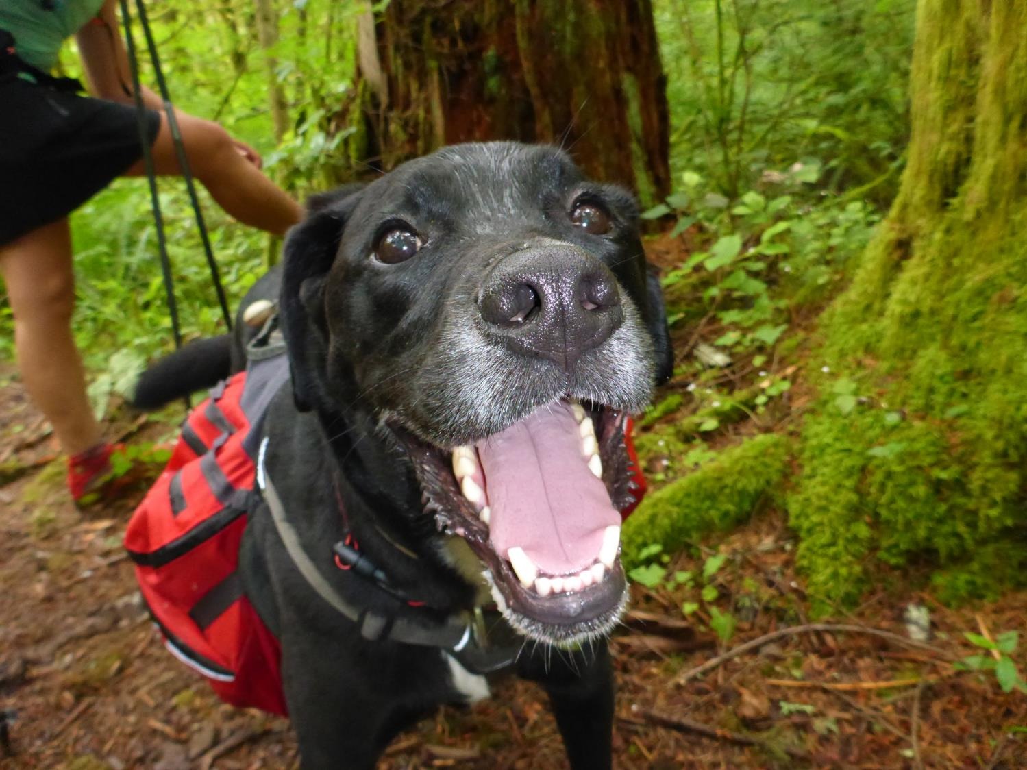

Slide 10
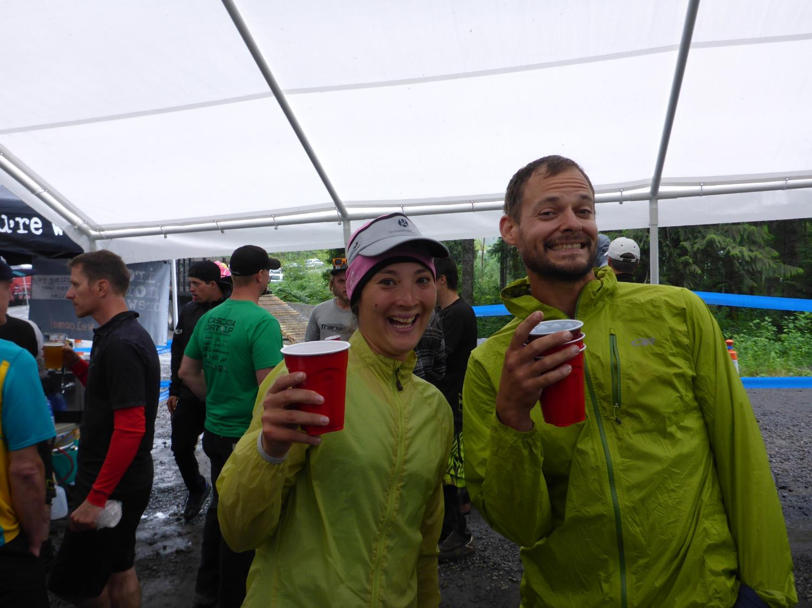

Slide 11
Day 2, June 29
Tarbell Picnic Area to Swampy Area North of Mowich Butte (33 miles)
Used
Tarbell Trail
Chinook Trail
Bluff Mountain Trail
FS Rd 43
Weather-50’s-60’s and rainy
First re-route, Snag Creek trail did not exist
Detours & route finding made for a very long day

Slide 12
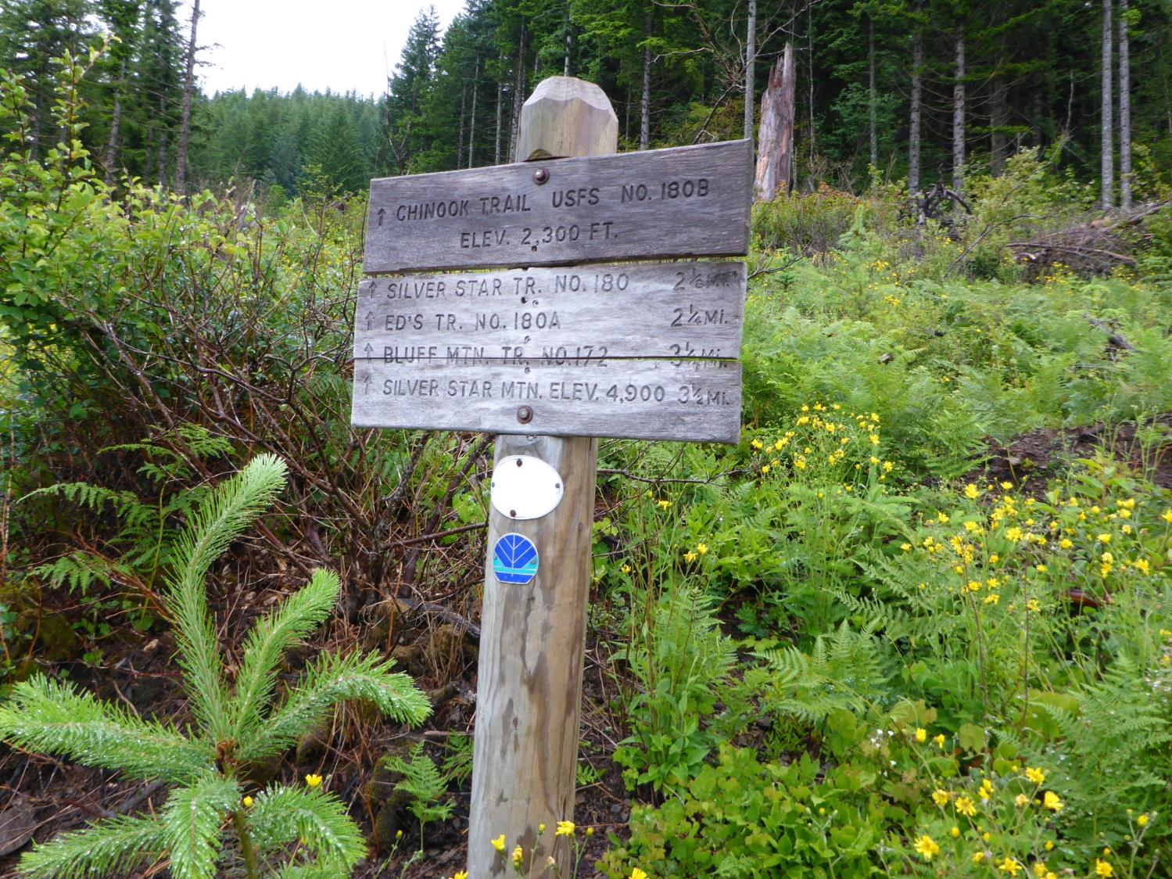

Slide 13
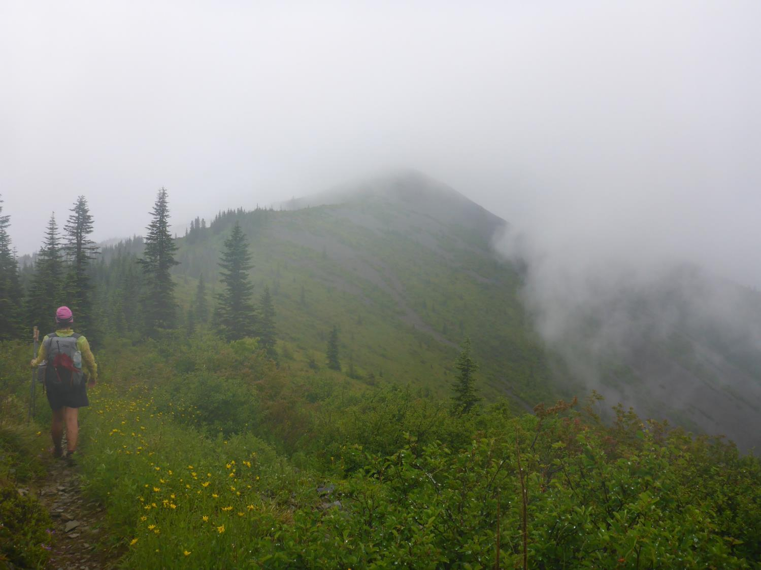

Slide 14
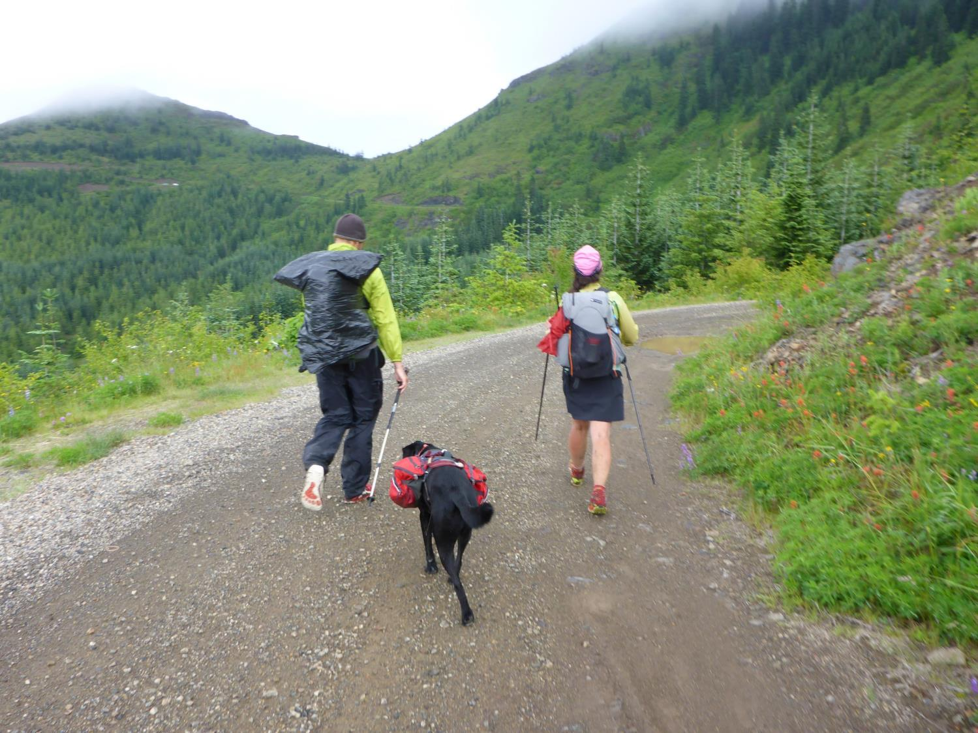

Slide 15
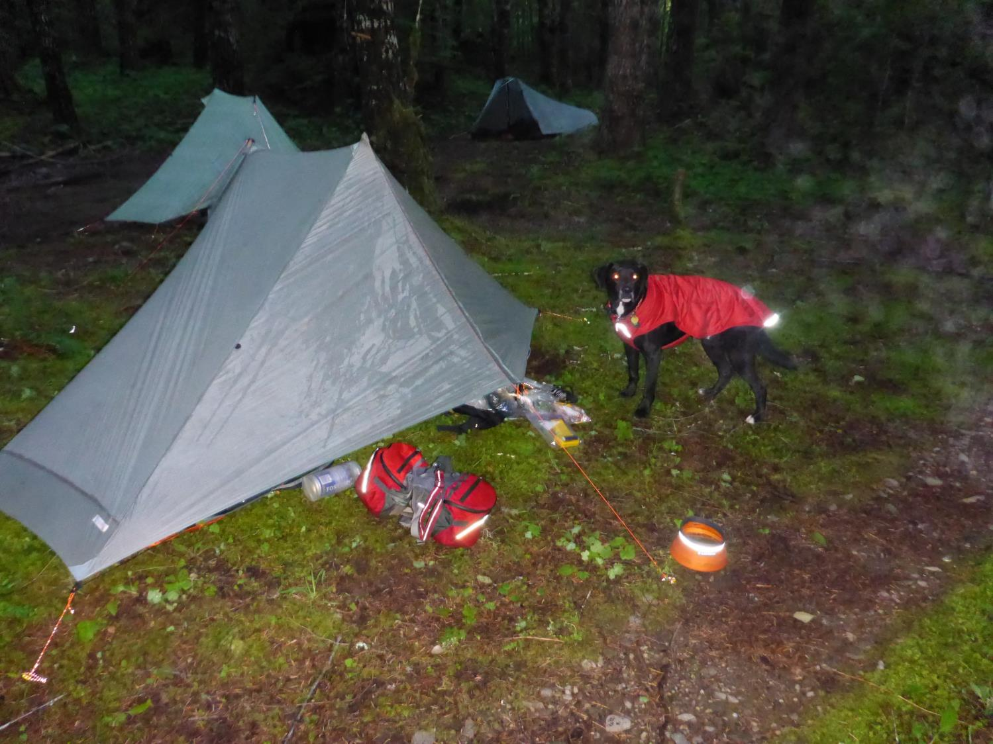

Slide 16
Day 3, June 30
FS Rd 43 to FS Rd 66, camped just west of Willard, WA (33 miles)
Trails & Roads Used
FS Rd 43
PCT by Wind River Valley
Grassy Knoll Trail No. 146
Triangle Pass walked west on FS Rd 66
Weather, Cool morning temps warmed quickly into the 80’s
Grassy Knoll was a beautiful hike with amazing views
Lack of water later in the day caused us to camp dry until morning

Slide 17
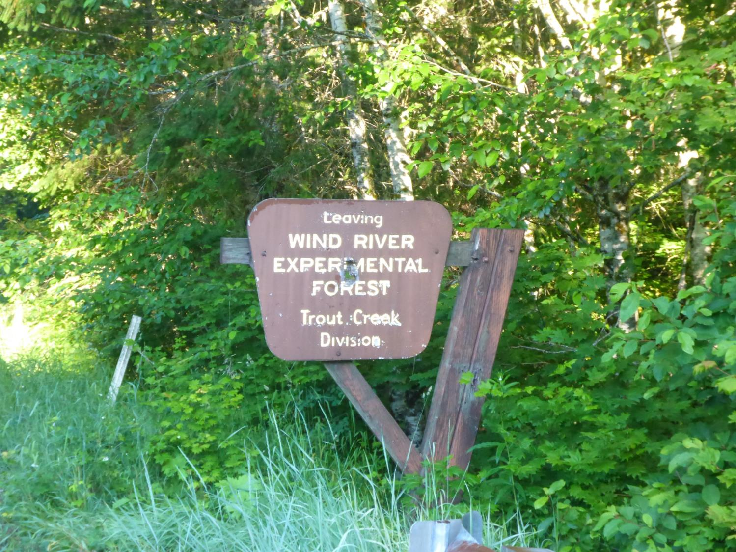

Slide 18
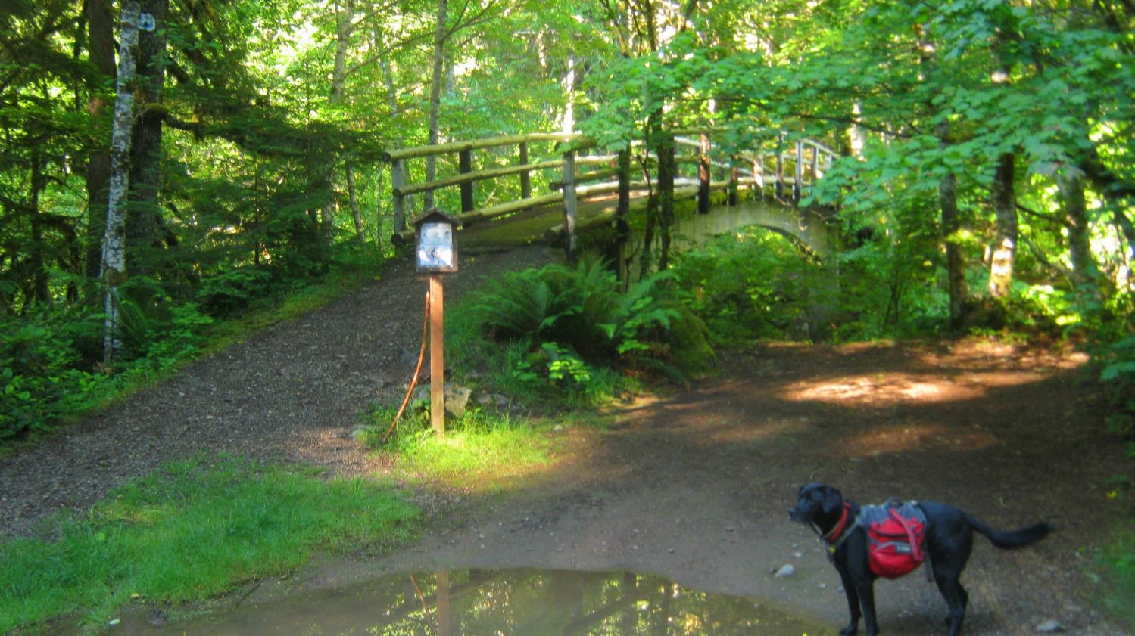

Slide 19
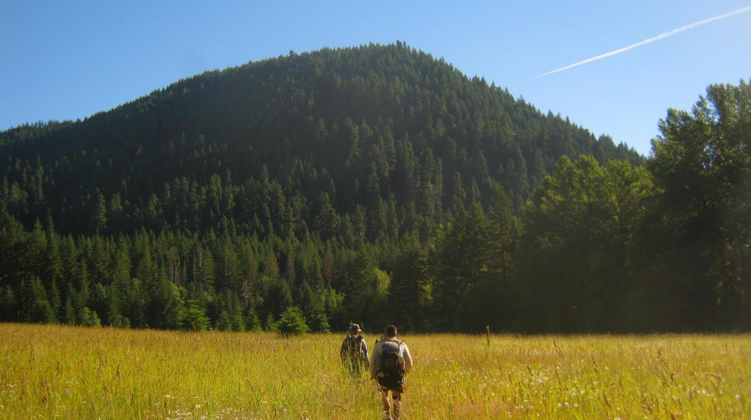

Slide 20
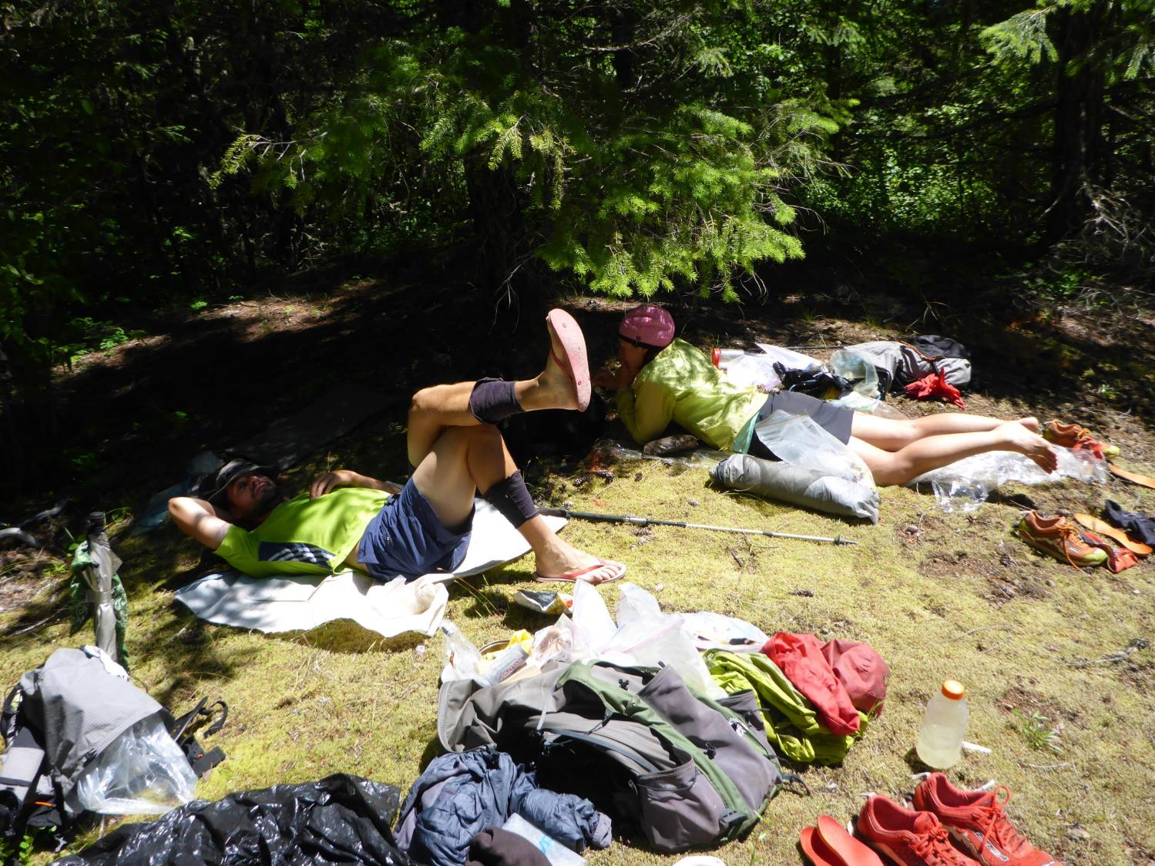

Slide 21
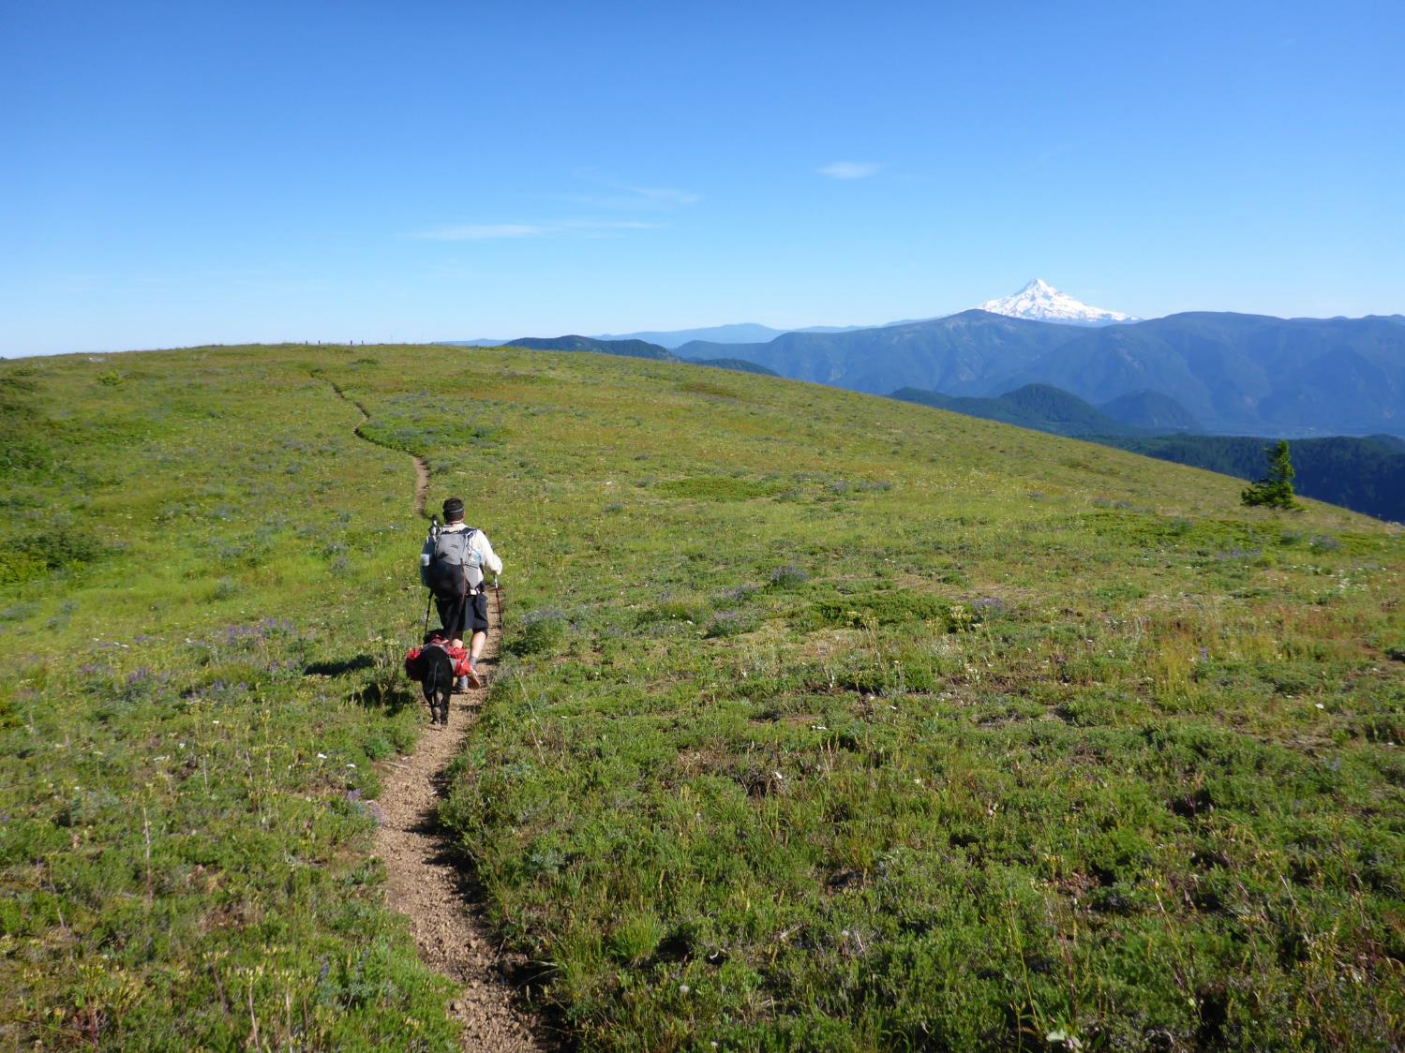

Slide 22
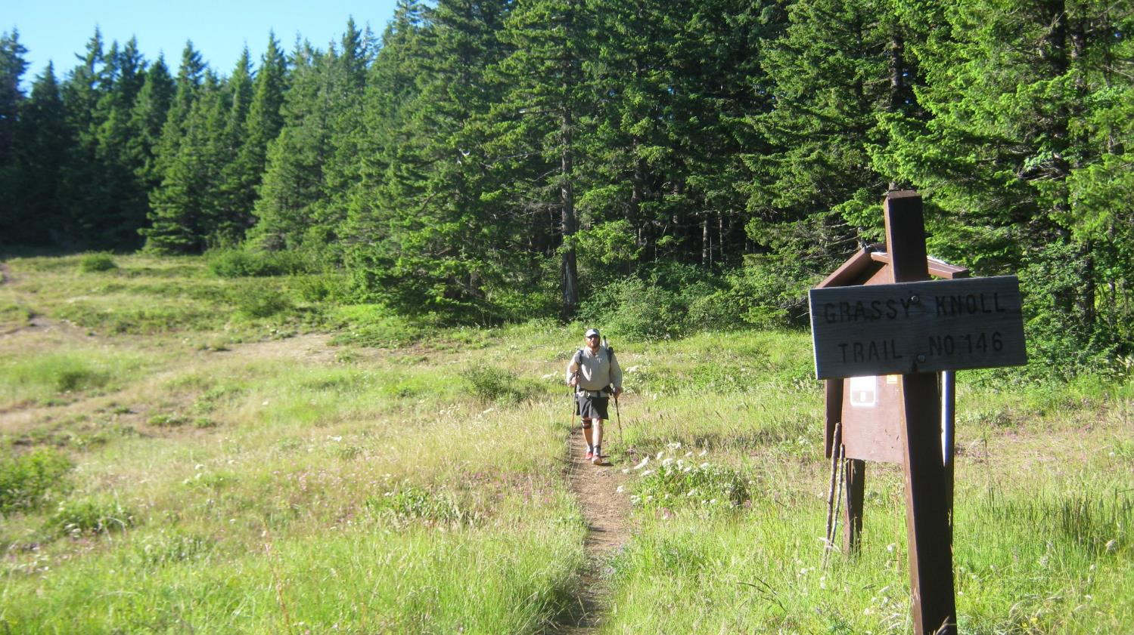

Slide 23
Day 4, July 1
FS Rd 66 (dry camp) to Bingen, WA (32 miles)
Roads & Trails Used
FS Rd 66
FS Rd 4000 to Nestor Peak
WDFW Buck Creek Trail
SR 141 (Husum to Bingen)
Weather-Heat Wave hits, 97 degrees
Dog struggled with the heat
Had to hitch the last 4 miles into town
Stayed at the Bingen School Inn

Slide 24
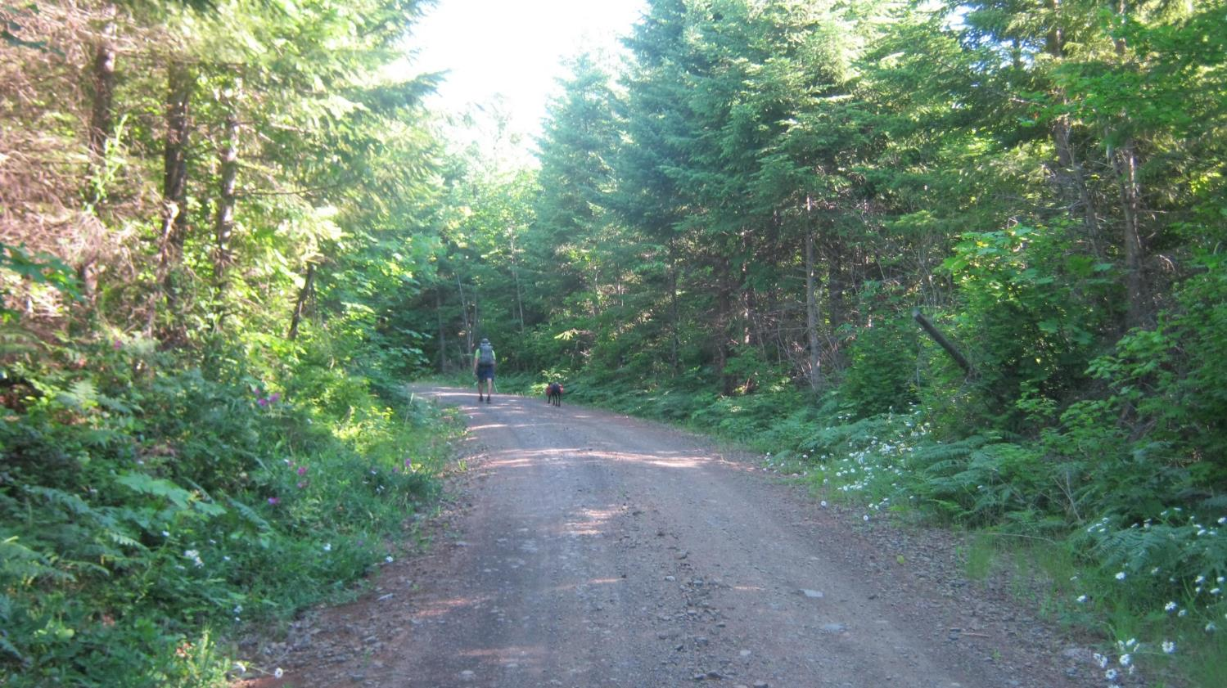

Slide 25
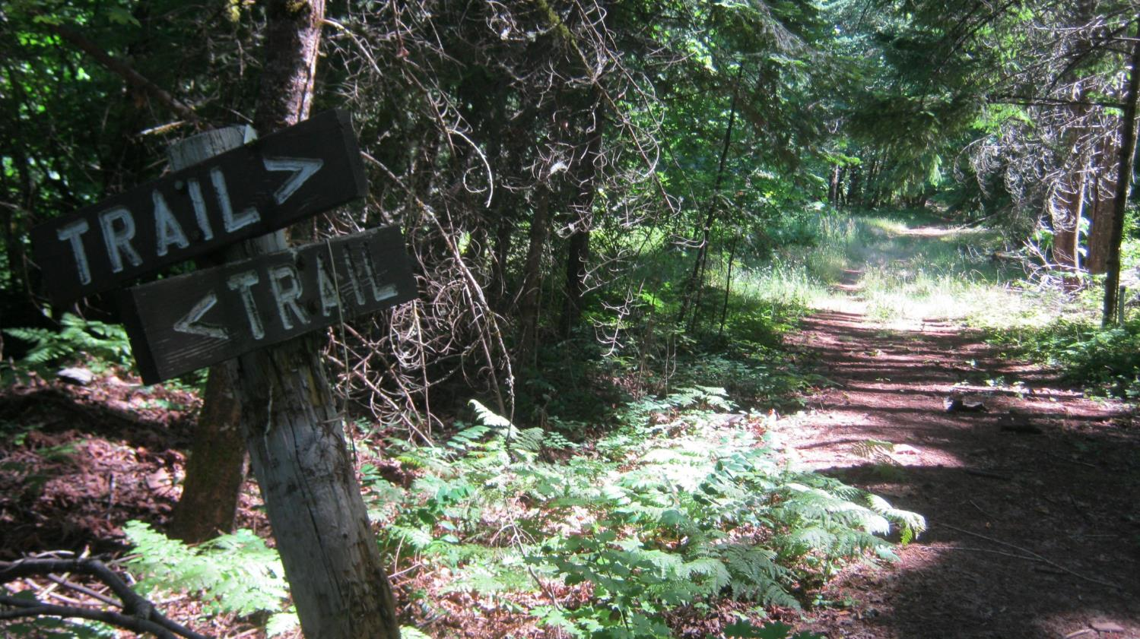

Slide 27
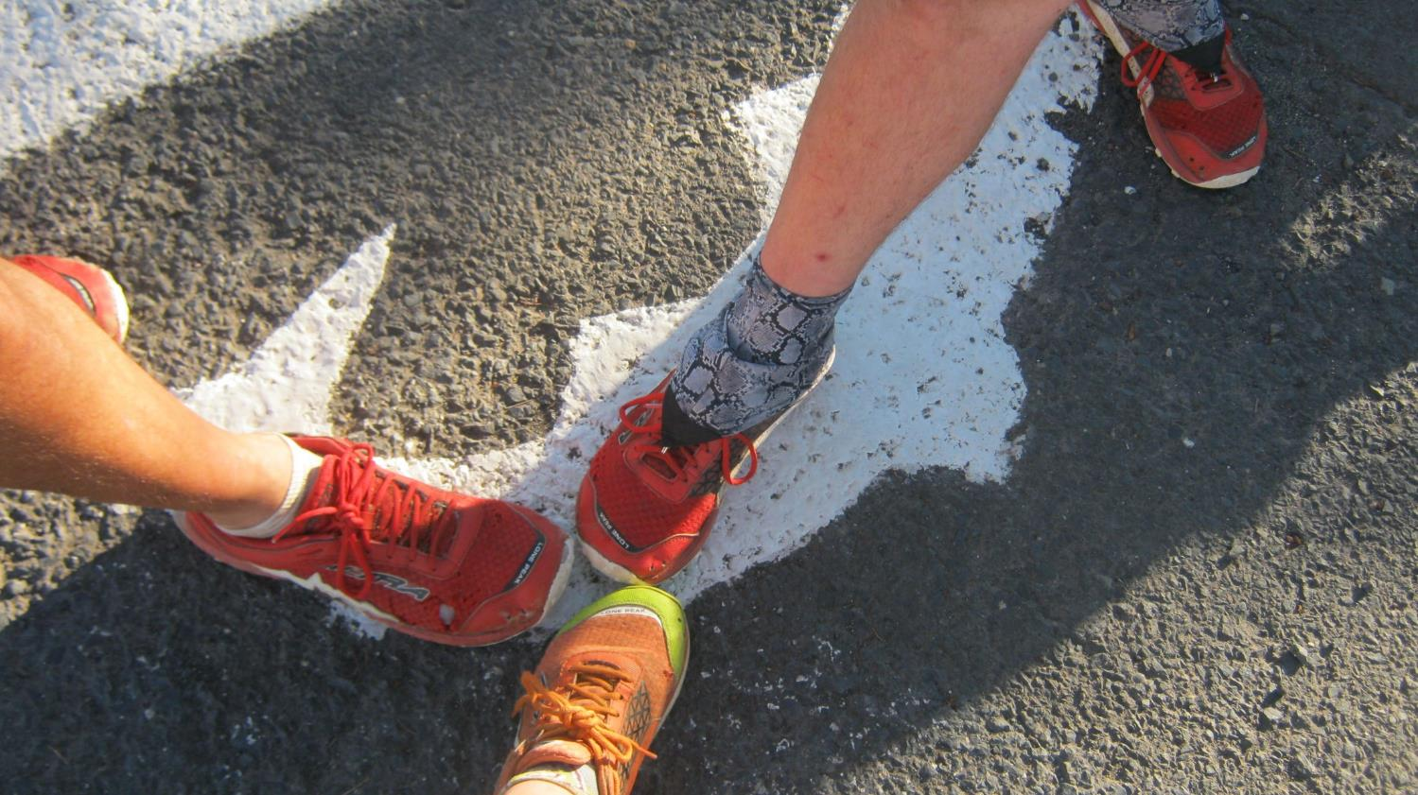

Slide 28
Day 5, July 2
Bingen, WA to Wahkiacus WDFW Campground (24 miles)
Roads & Trails Used
SR 14
Old Highway 8
Klickitat Trail
Stoped for breakfast in Lyle and Dinner in Klickitat, WA
Weather-Hot High 90’s
Stopped in Klickitat at the Canyon Market to wait out the heat
Met lots of friendly folks along the way in towns we passed through

Slide 30
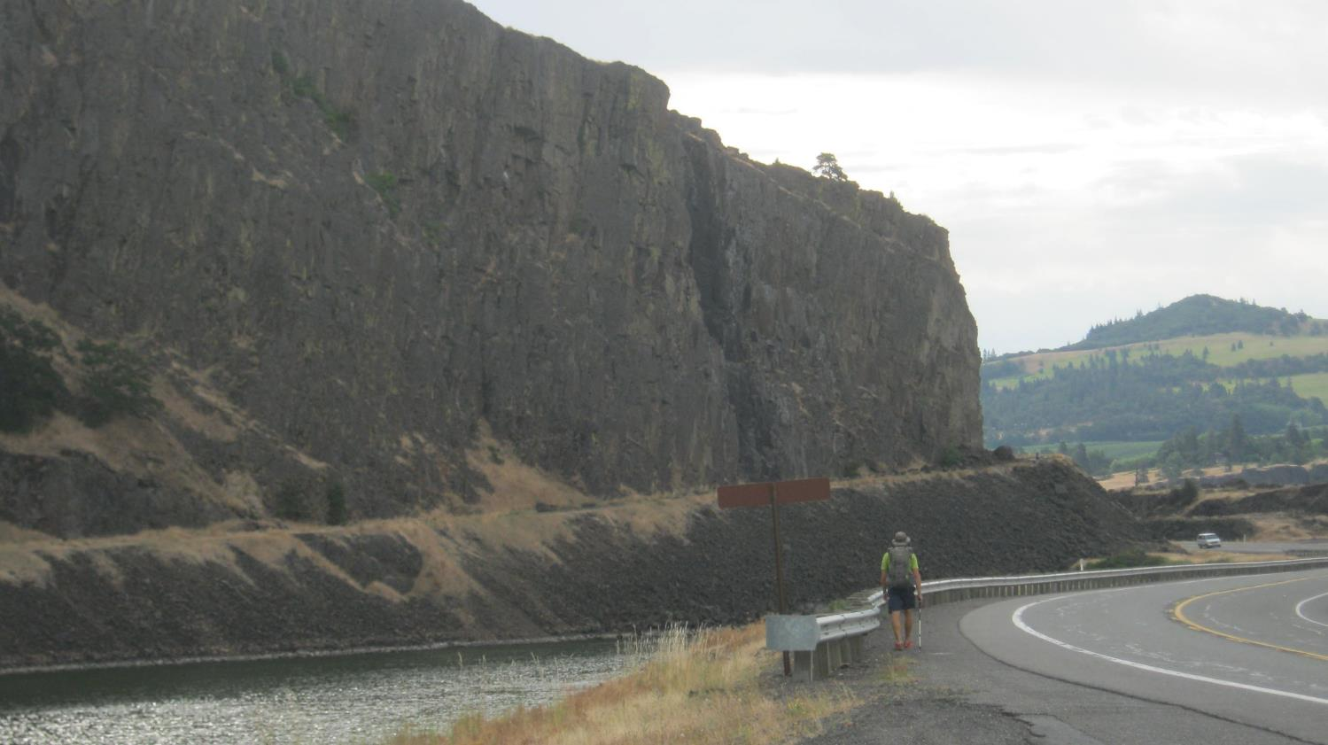

Slide 31
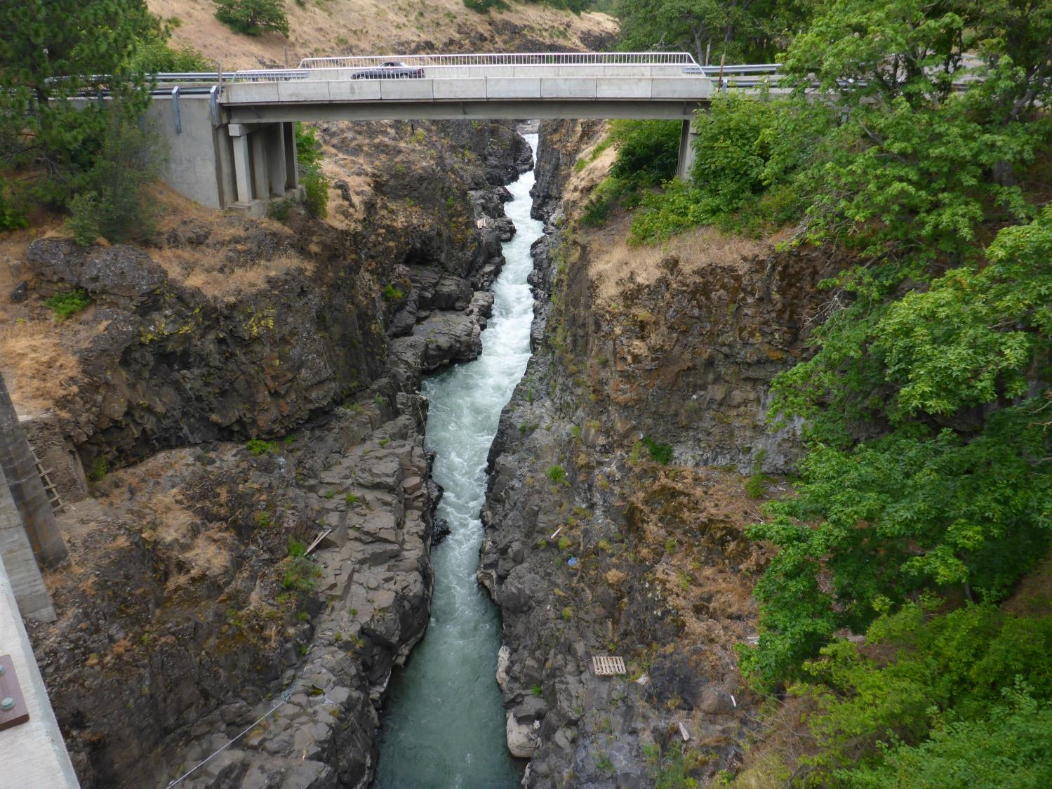

Slide 32
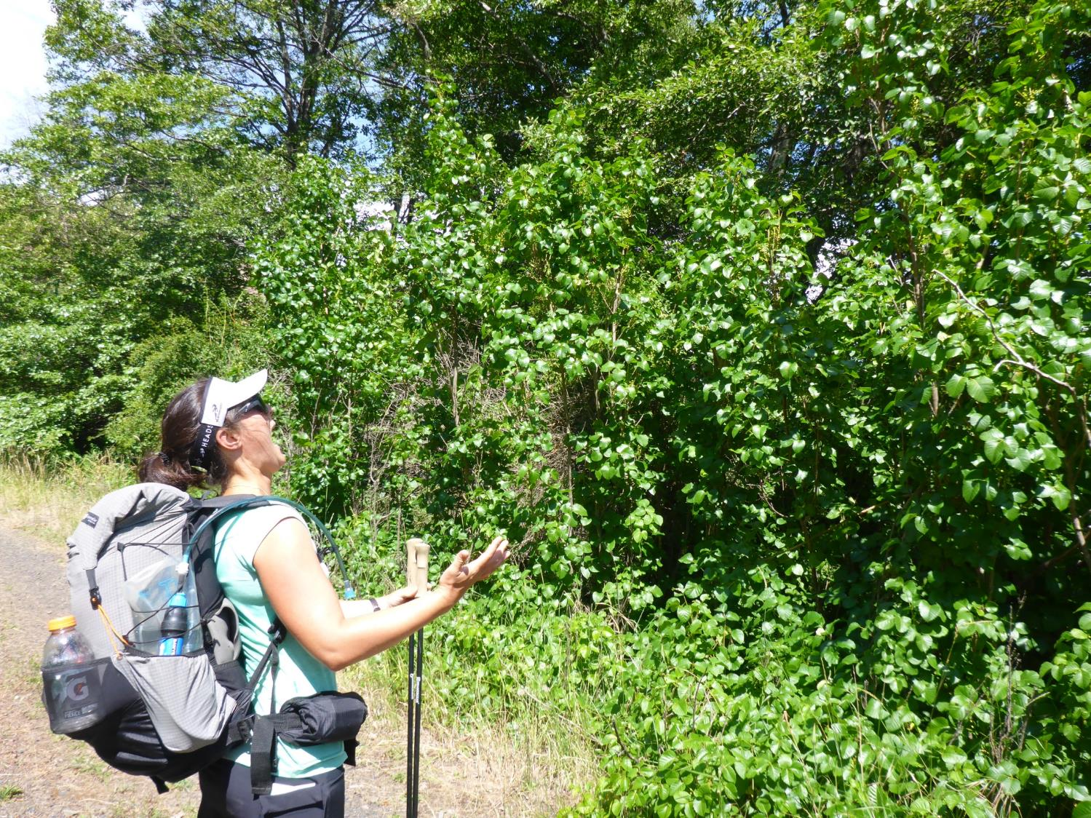

Slide 33
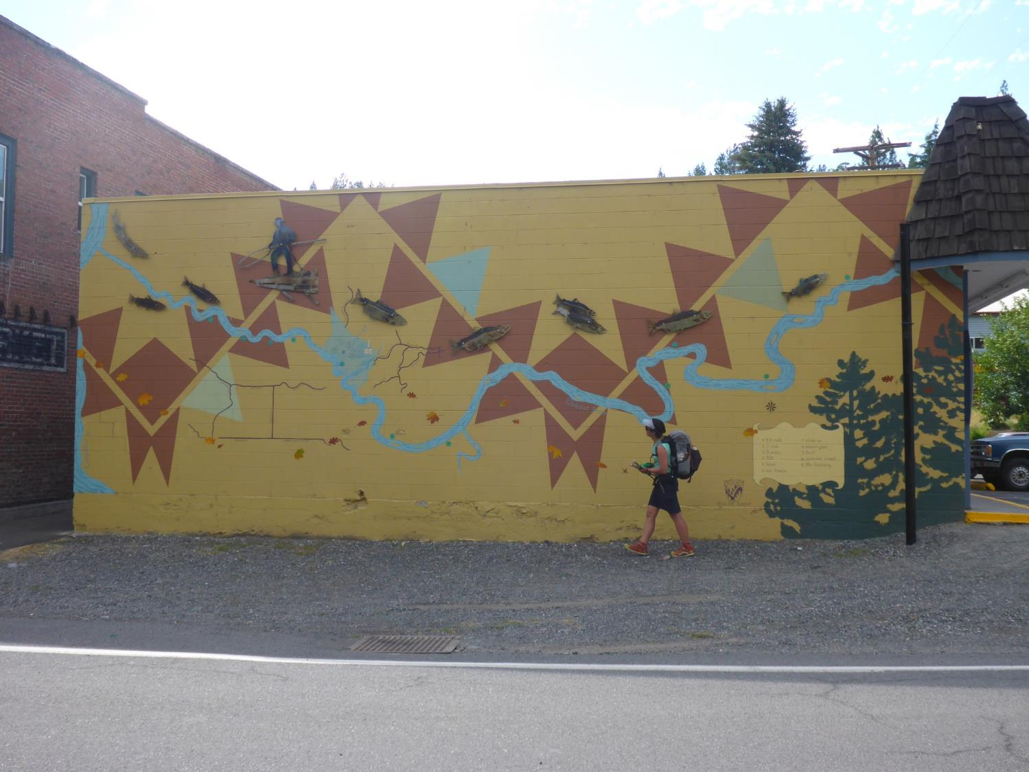

Slide 34
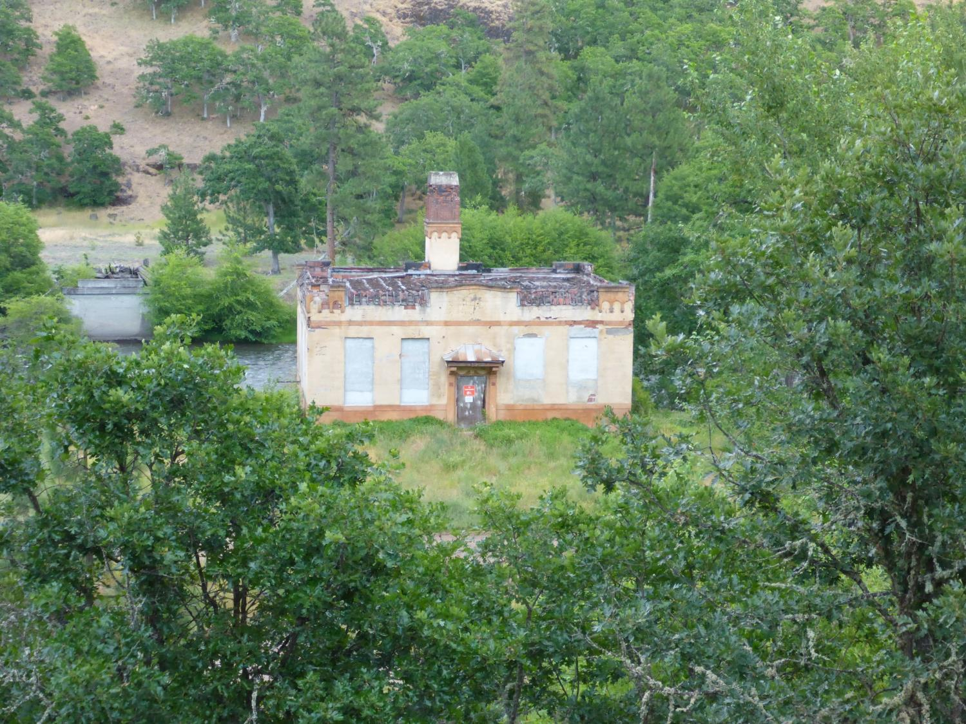

Slide 35
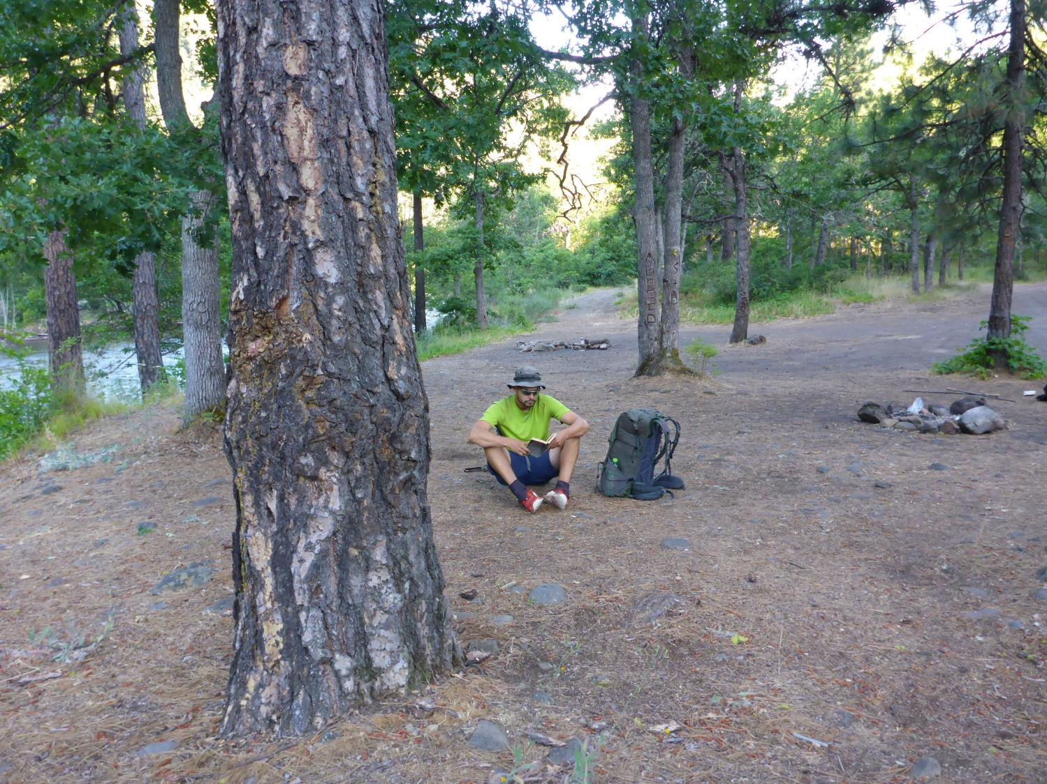

Slide 36
Day 6, July 3
Wahkiacus to Maryhill State Park (25 miles)
Roads and Trails Used
Rails to Trails, Klickitat Trail through Swale Creek Canyon
Dalles Mountain Road
Rattlesnake Ridge Road
Cross Country Down Bluff
Highway 97 S
Weather Hot and dry High 90’s
Swale Creek Canyon is closed July 15-Oct 15
Had to trespass to HWY 97
Walk down Hwy 97 was Sketchy

Slide 37
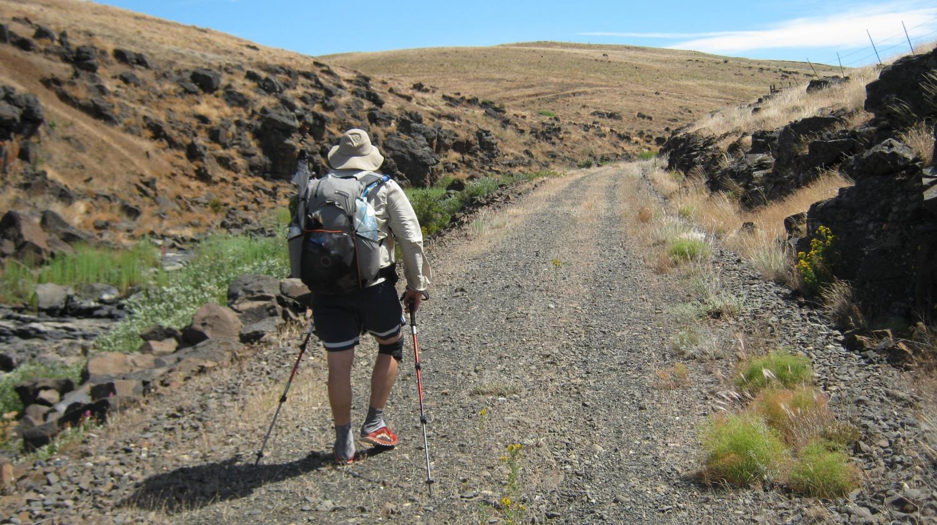

Slide 38
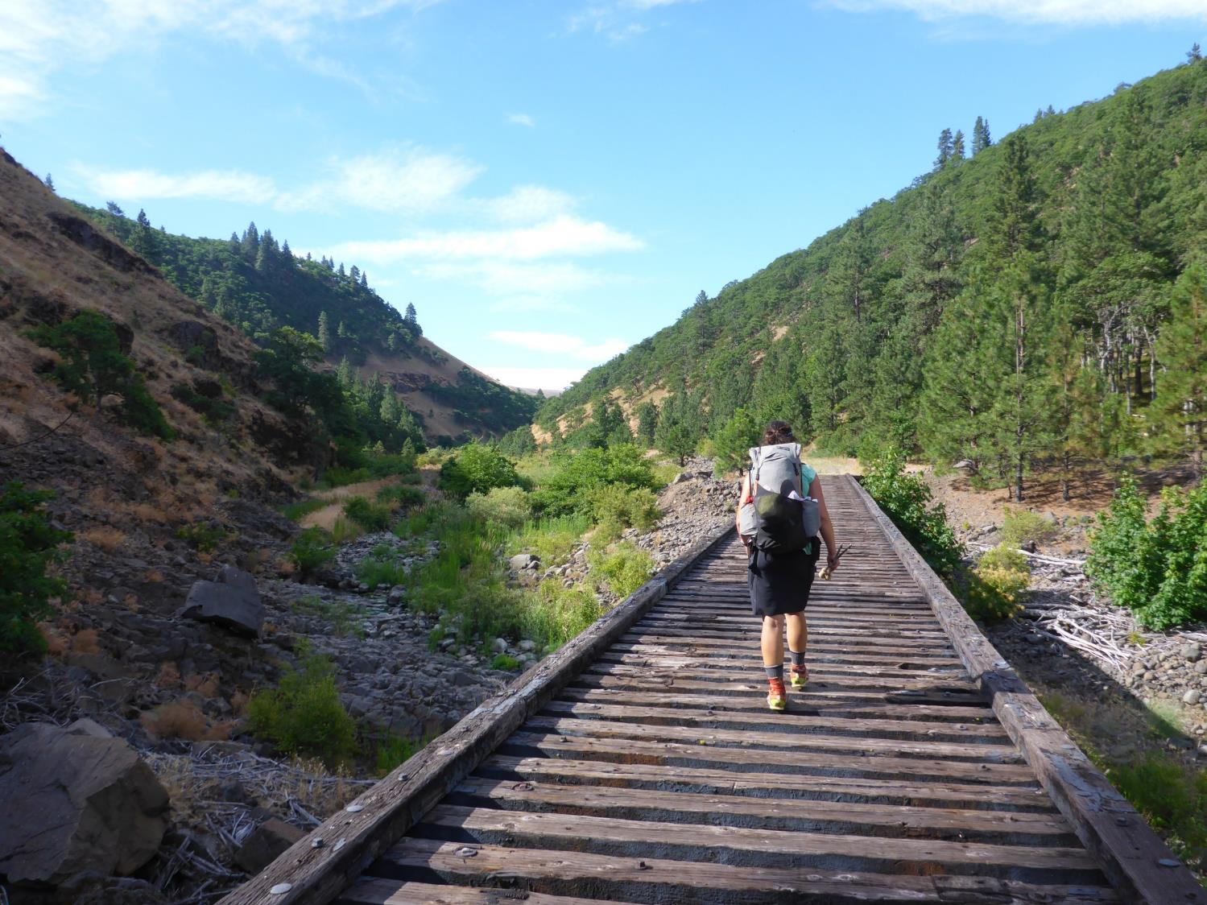

Slide 39
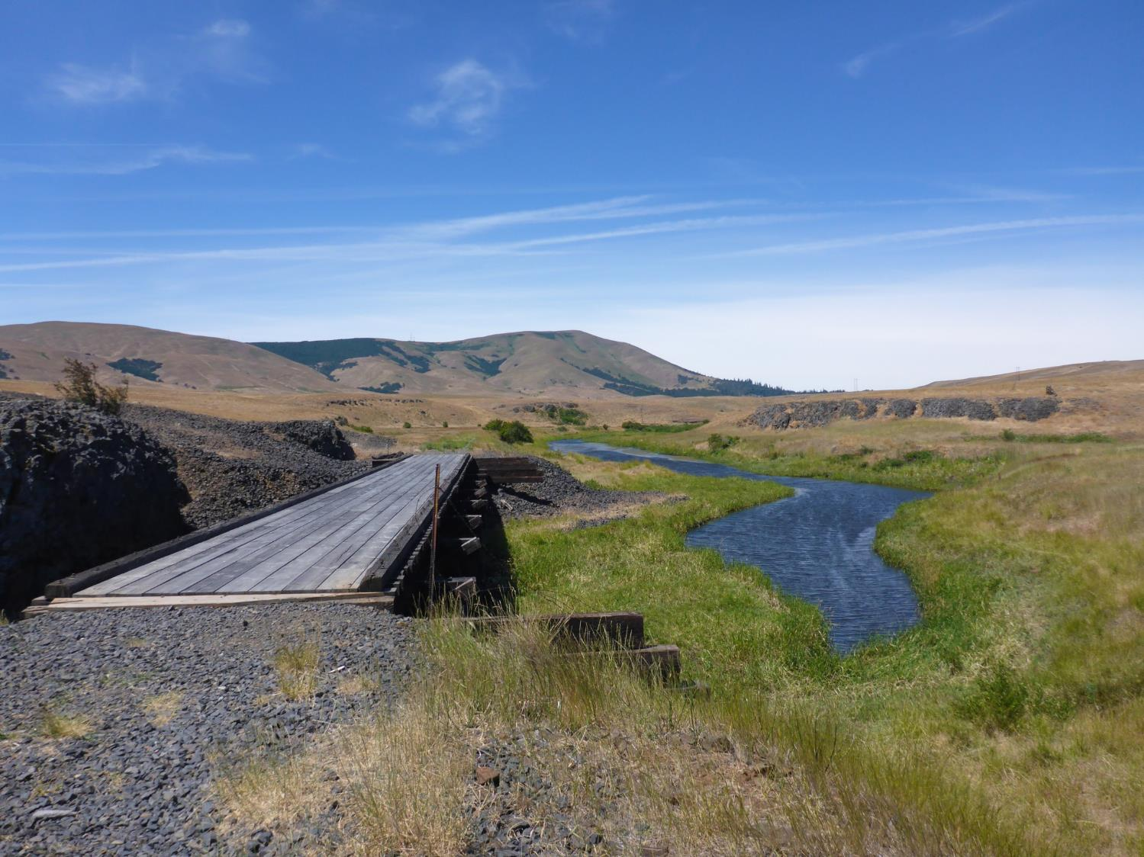

Slide 40
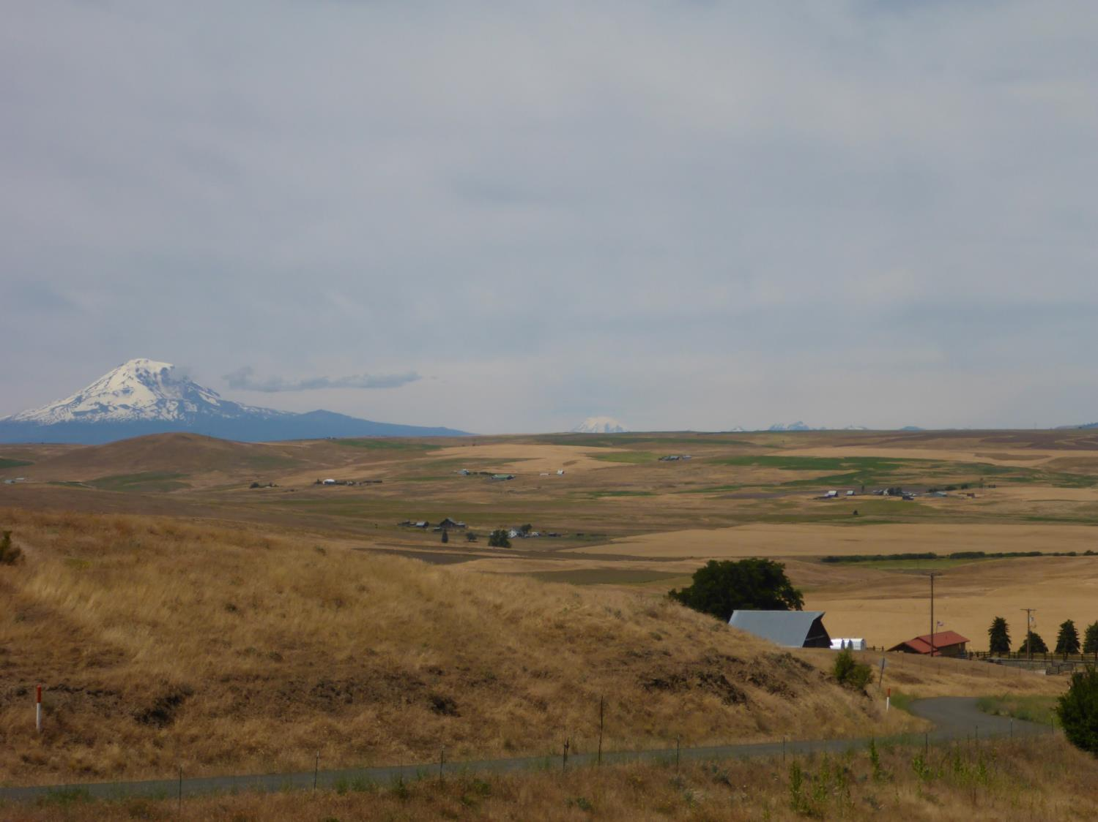

Slide 41
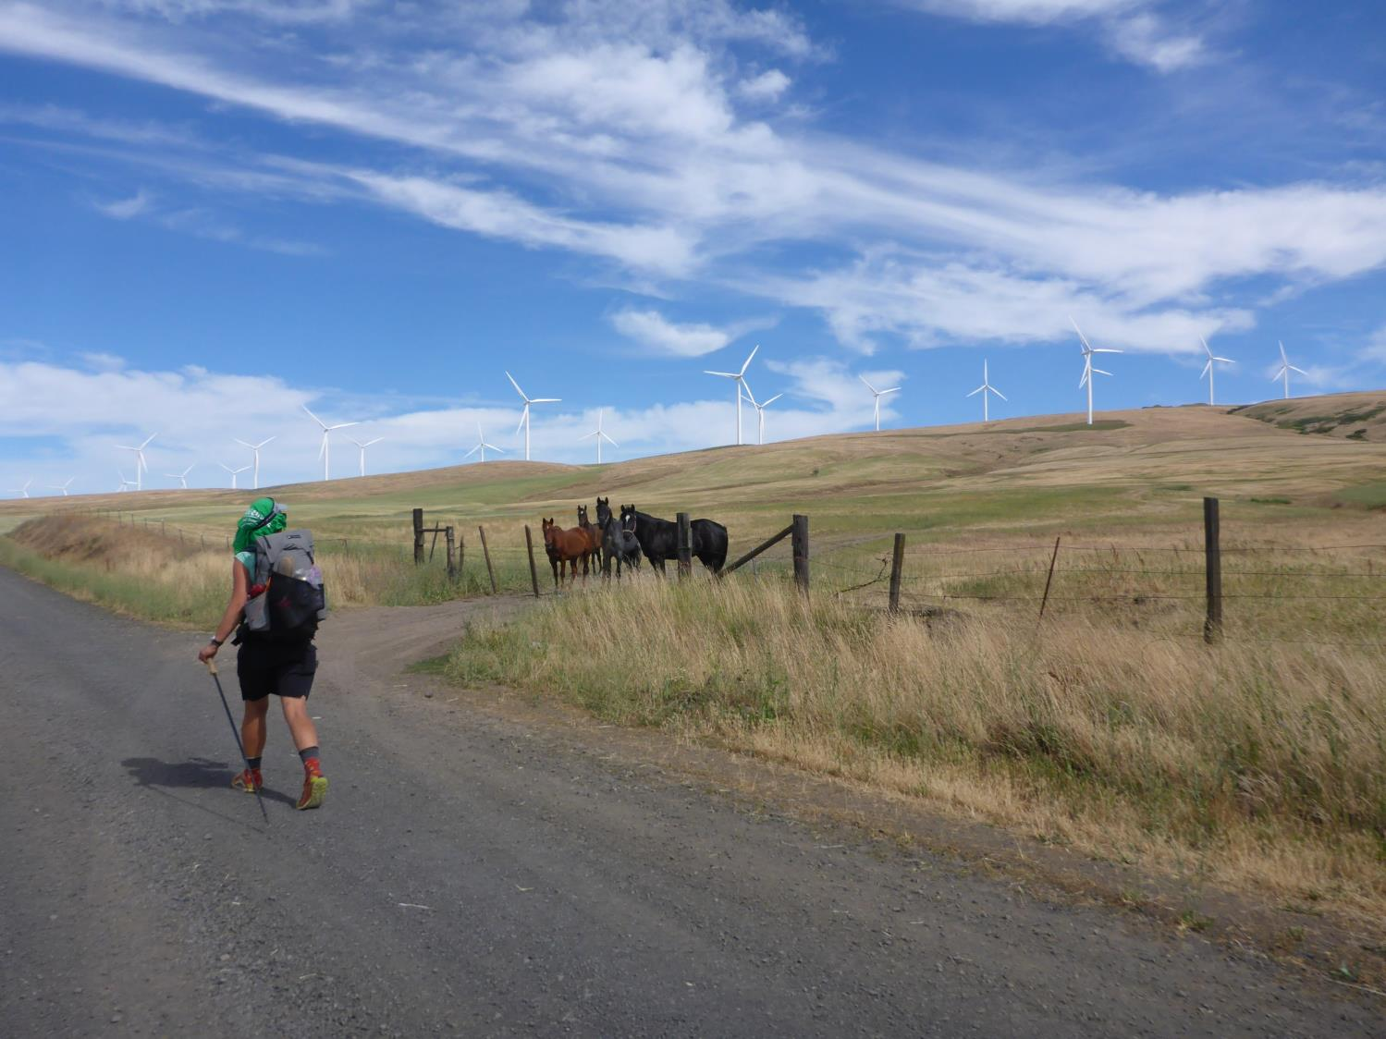

Slide 42
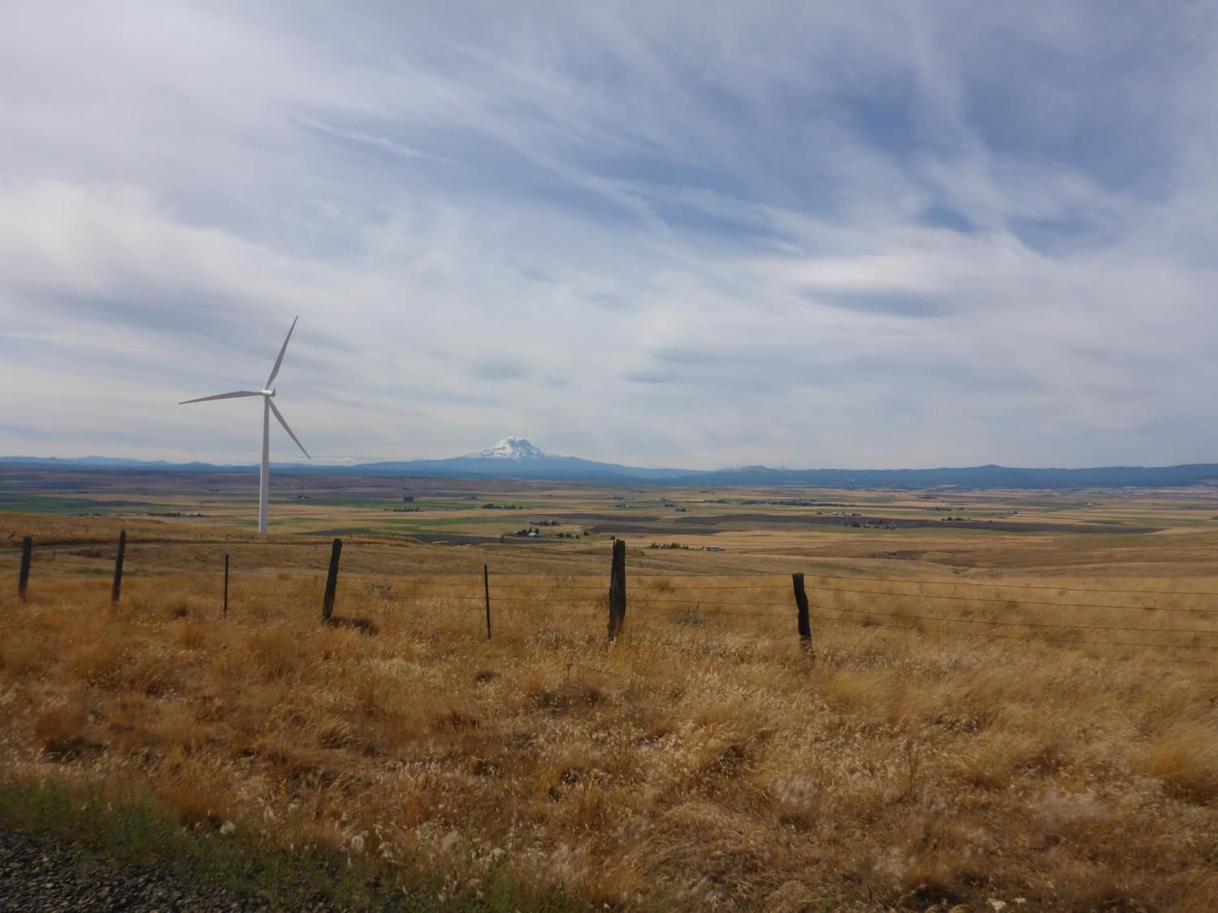

Slide 43
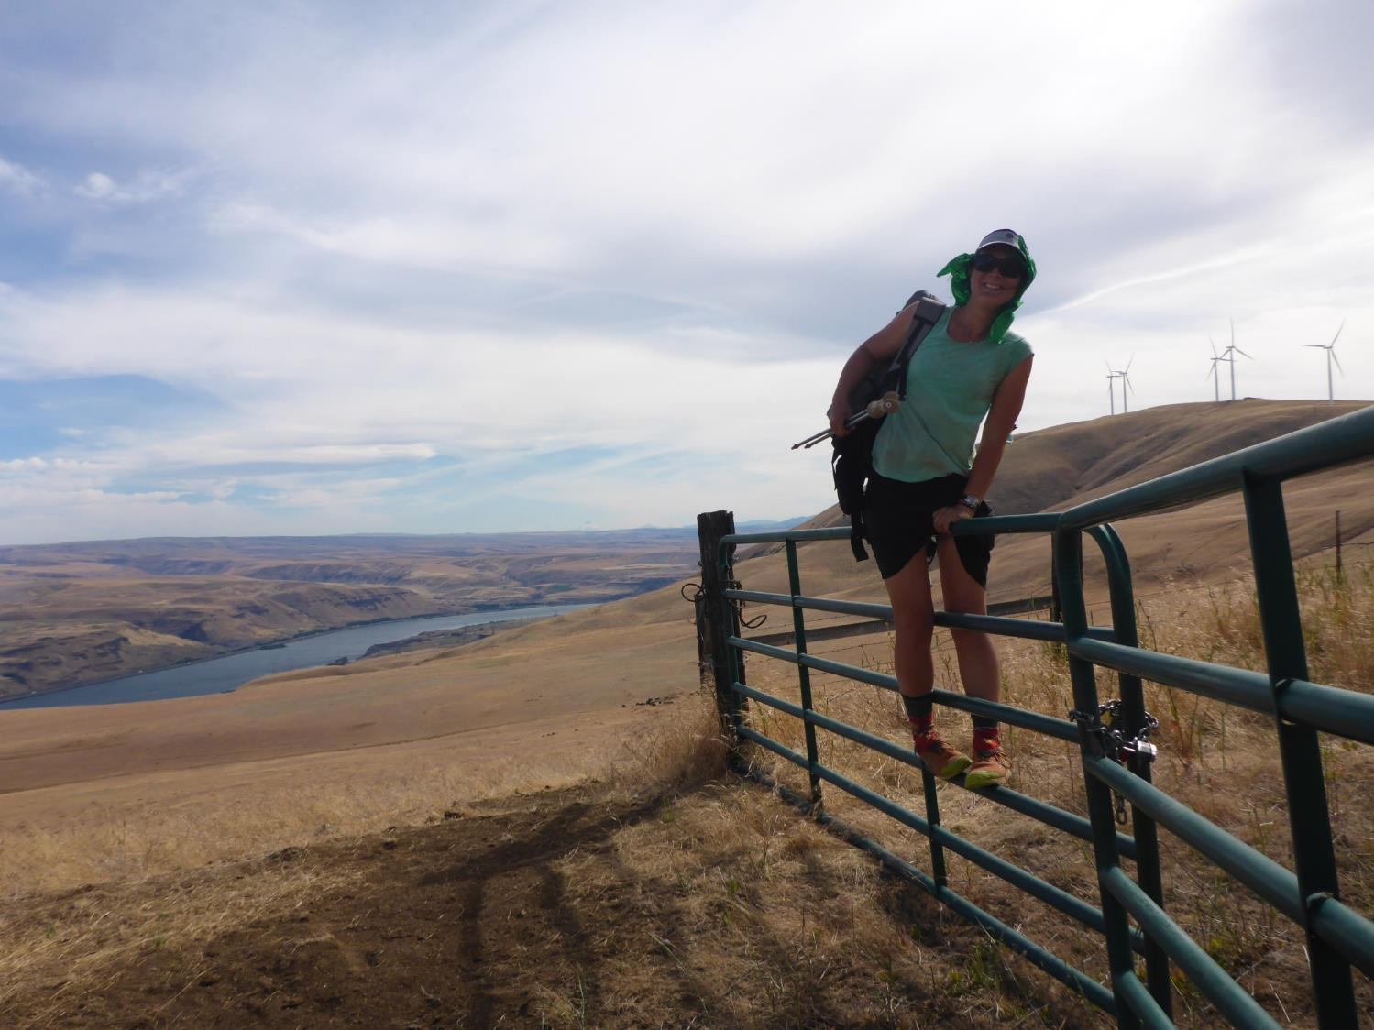

Slide 44
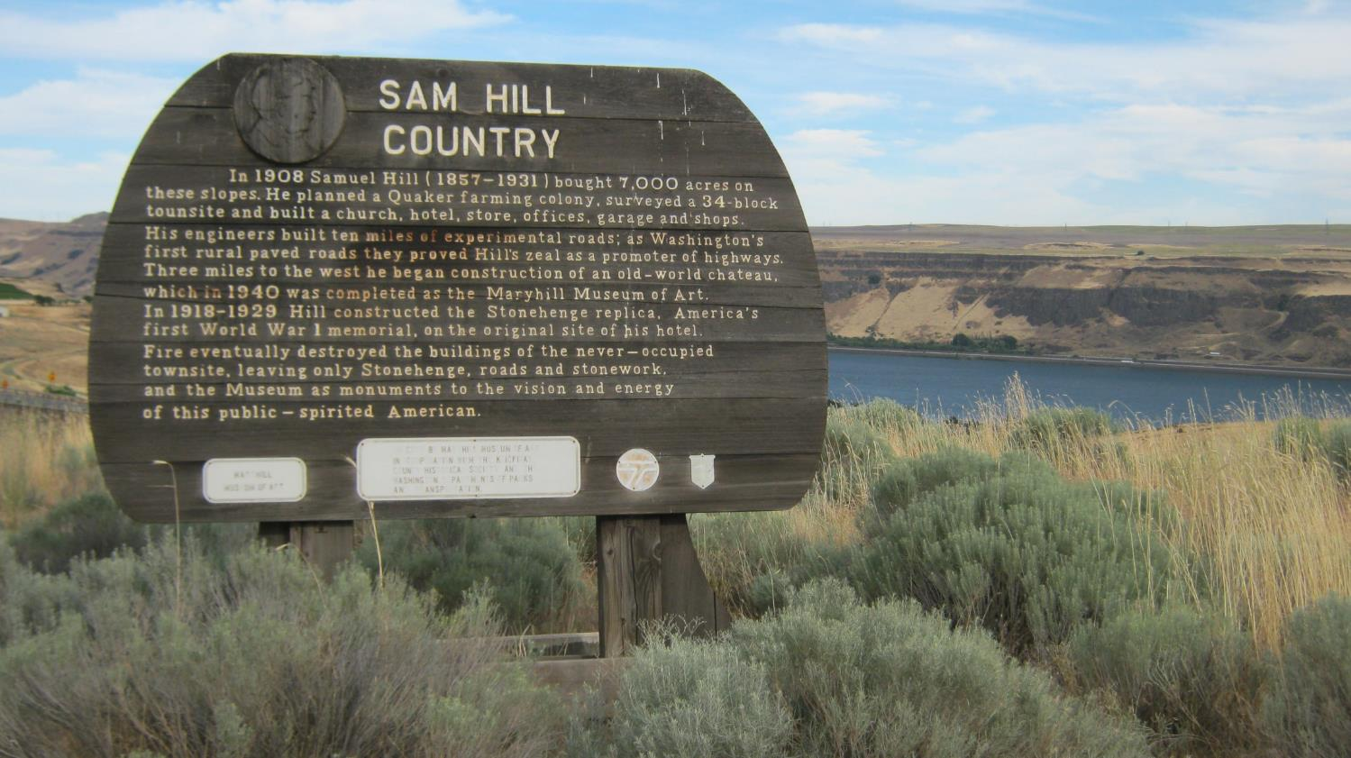

Slide 45
Day 7, July 4
Biggs Junction to The West end of The Dalles (30 miles)
Roads Used
Official Yellow Blaze over Columbia River
Old Hwy 30 to the Deschutes River
Old Moody Rd, McCoy Rd and Fifteen Mile Road (US Historical, Oregon Trail)
Weather, Hot Again Close to 100
Little to no shade after the Deschutes
Walked through many ranches along roads
Celebrated the 4th in The Dalles

Slide 46
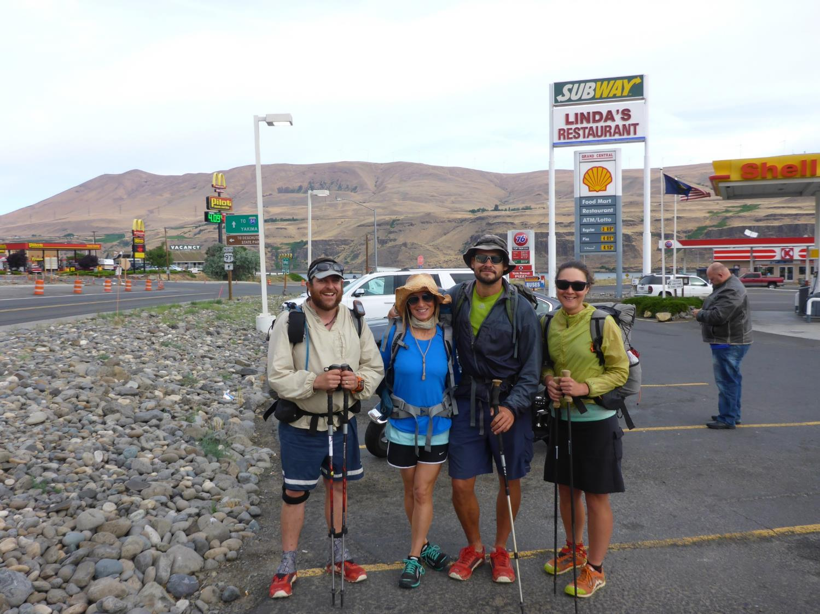

Slide 47
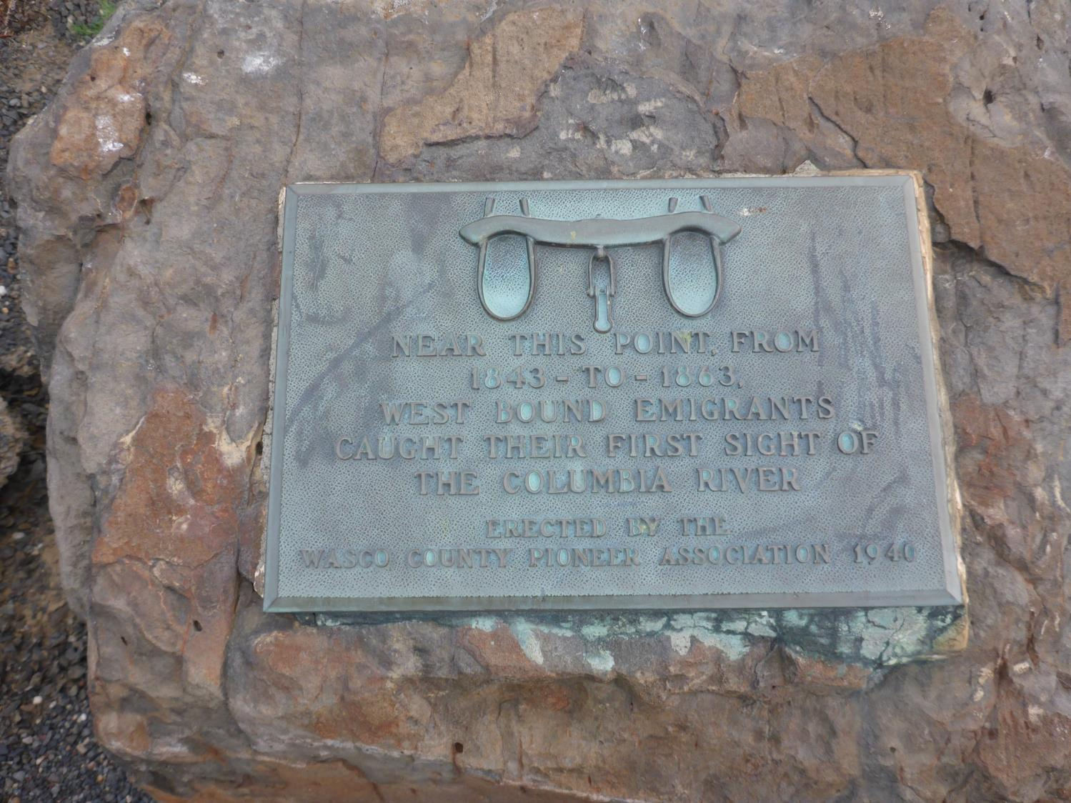

Slide 48
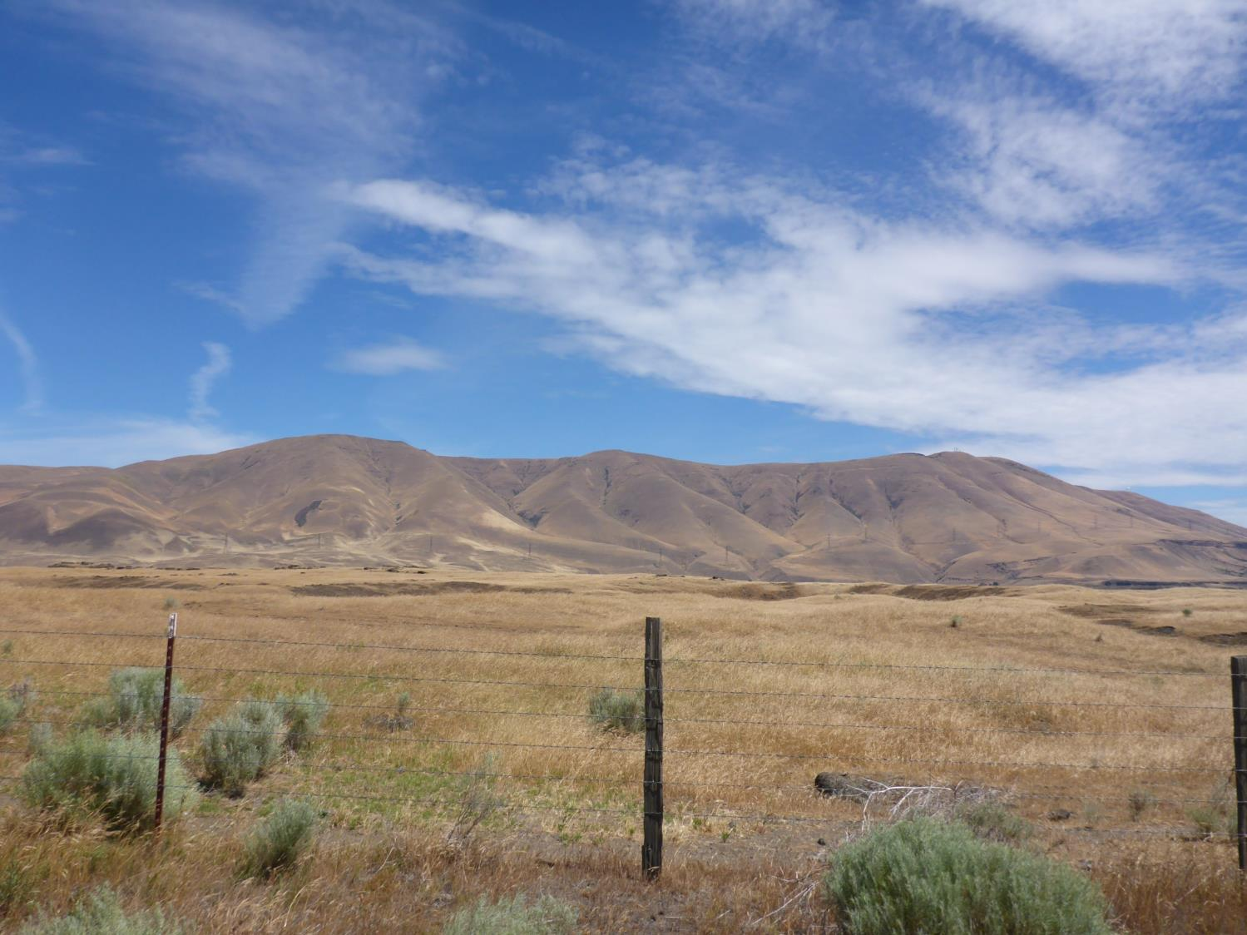

Slide 49
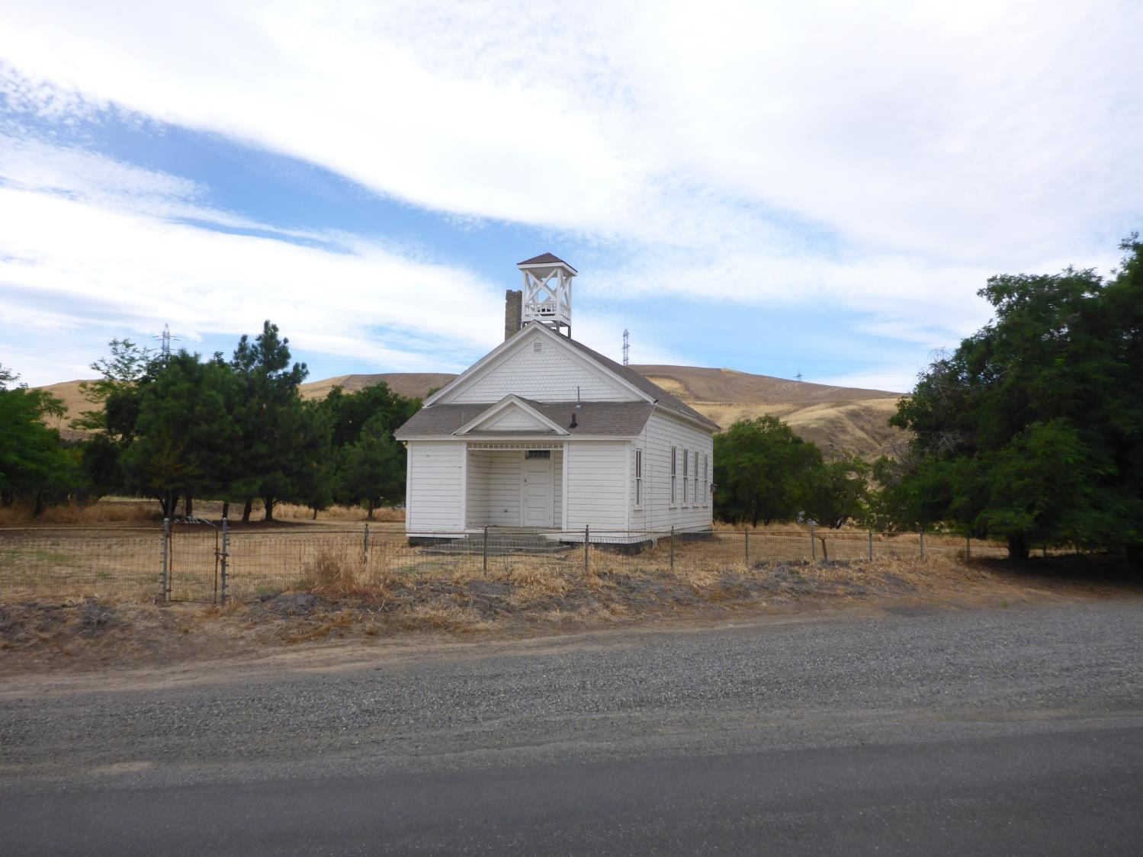

Slide 50
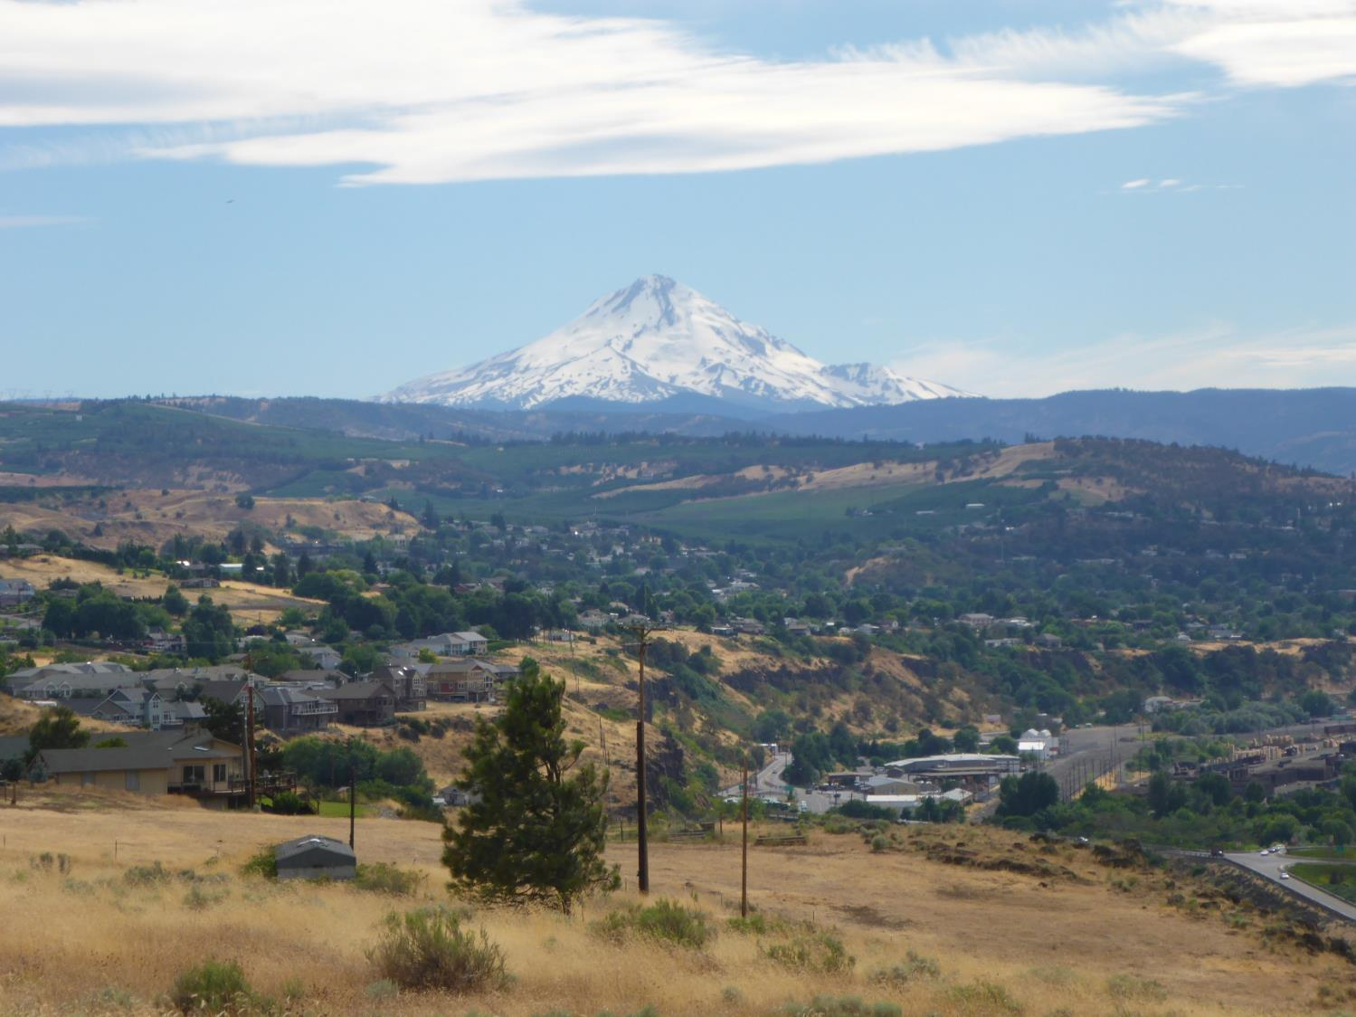

Slide 51
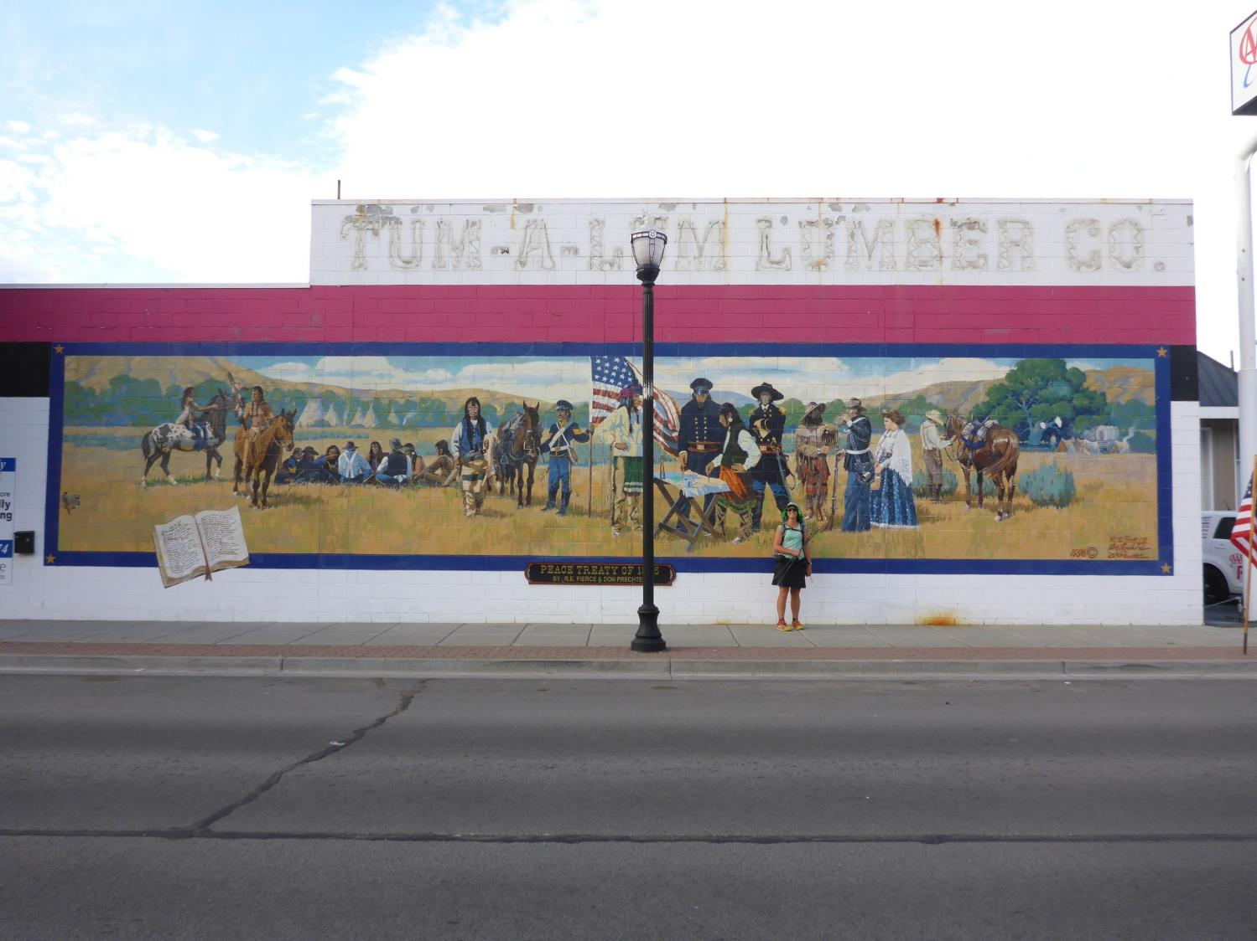

Slide 53
Day 8, July 5
The Dalles, OR to Hood River, OR (27-28 miles)
Roads & Trails Used
Old Hwy 30, Rowena Pt to Mosier, OR
Moiser Tunnel biker/hiker path to Hood River, OR
Main St Hood River
Weather-Hot and very Dry, Close to 100
Trail Magic from friends
Trail Angels of Hood River, OR
Devated from original plan (old Hwy 30 vs Seven Mile Hill Road)

Slide 54
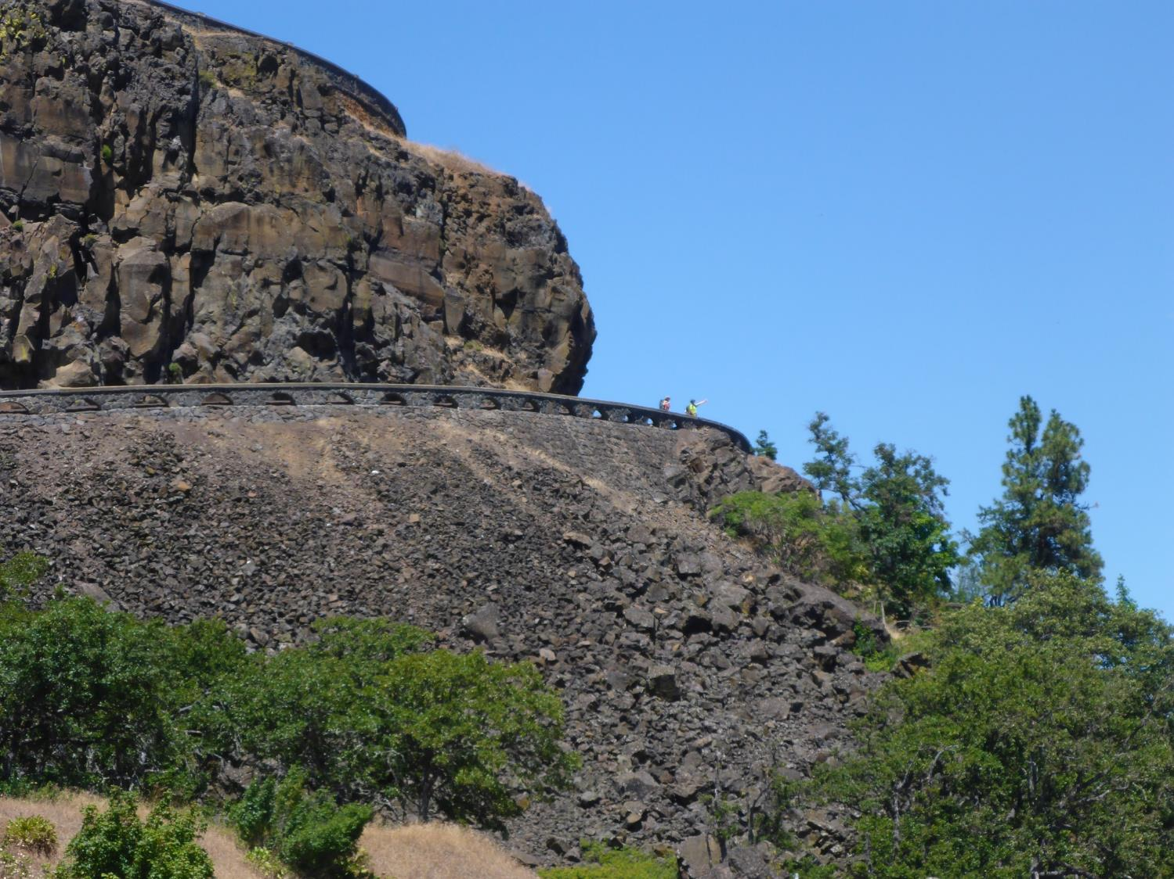

Slide 55
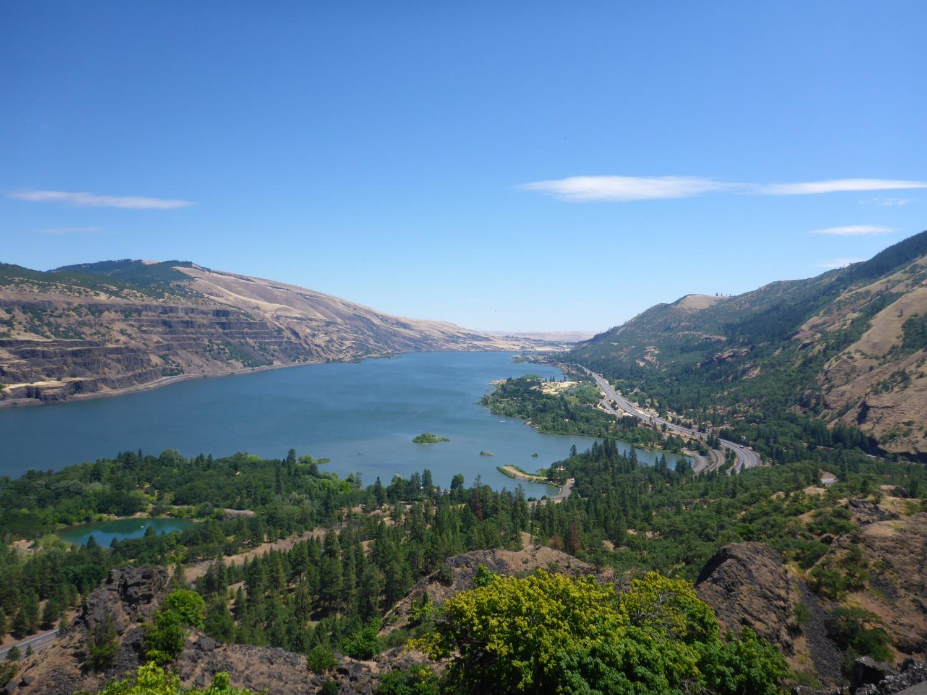

Slide 56
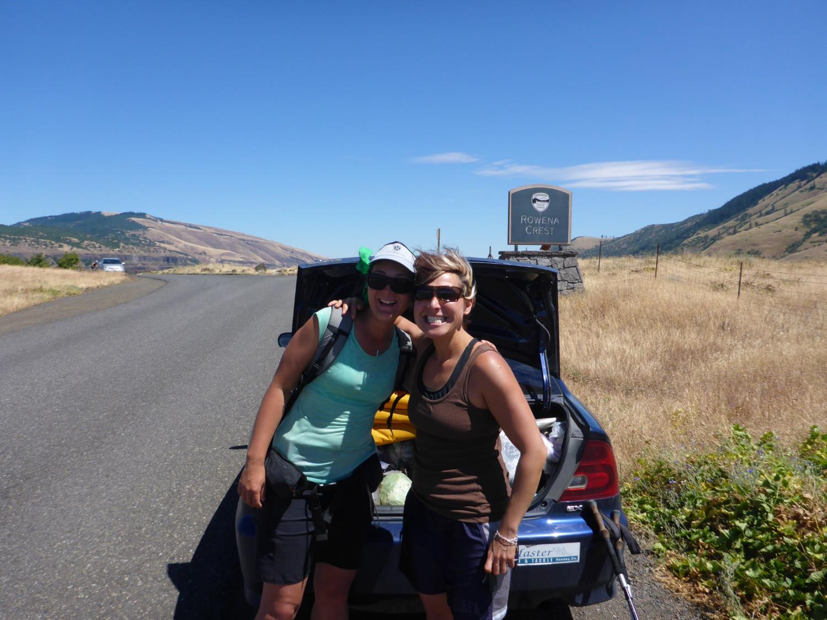

Slide 57
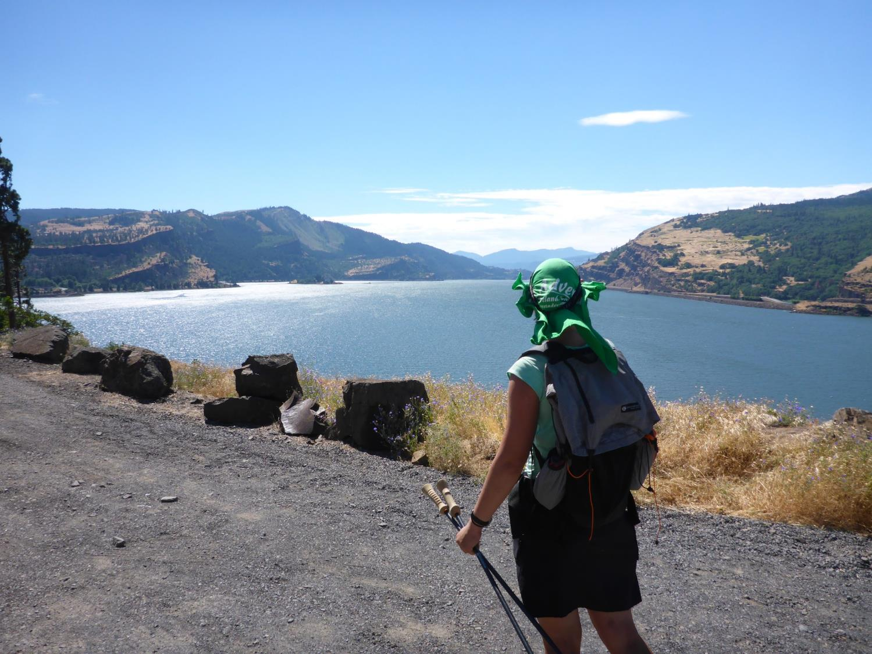

Slide 59
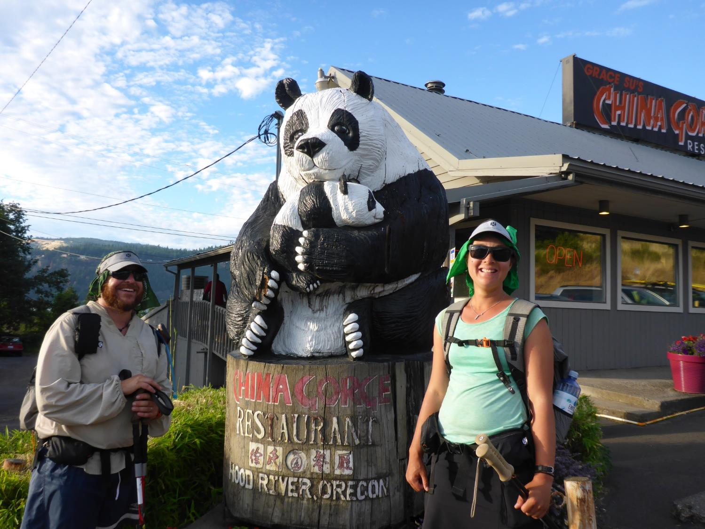

Slide 60
Day 9, July 6
Hood River, OR to Whatum Lake Camp Ground (28 miles)
Roads and Trails Used
Binns Hill Road
ATV Trails
Up to Mt Defiance (5,000’ in elevation)
Over to Whatum lake
Weather-Heat wave still was kicking another 90+ day
Stopped for berry & cherry picking
Amazing Spring at end of Binns Hill Rd
Long day-rolled into camp at dark

Slide 61
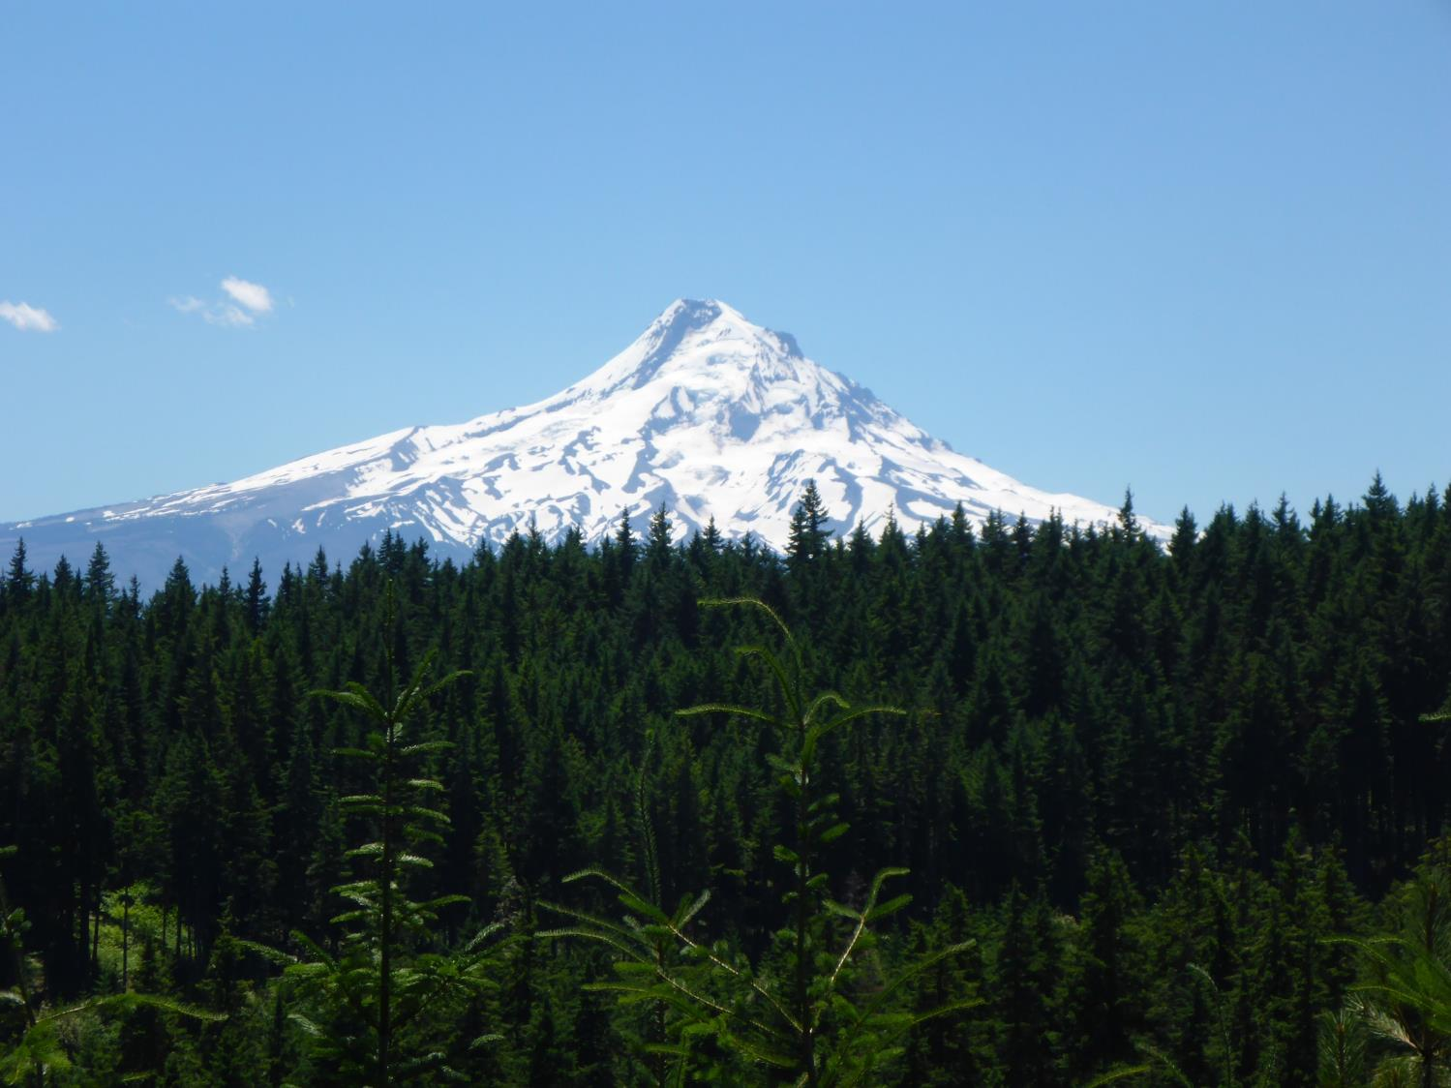

Slide 62
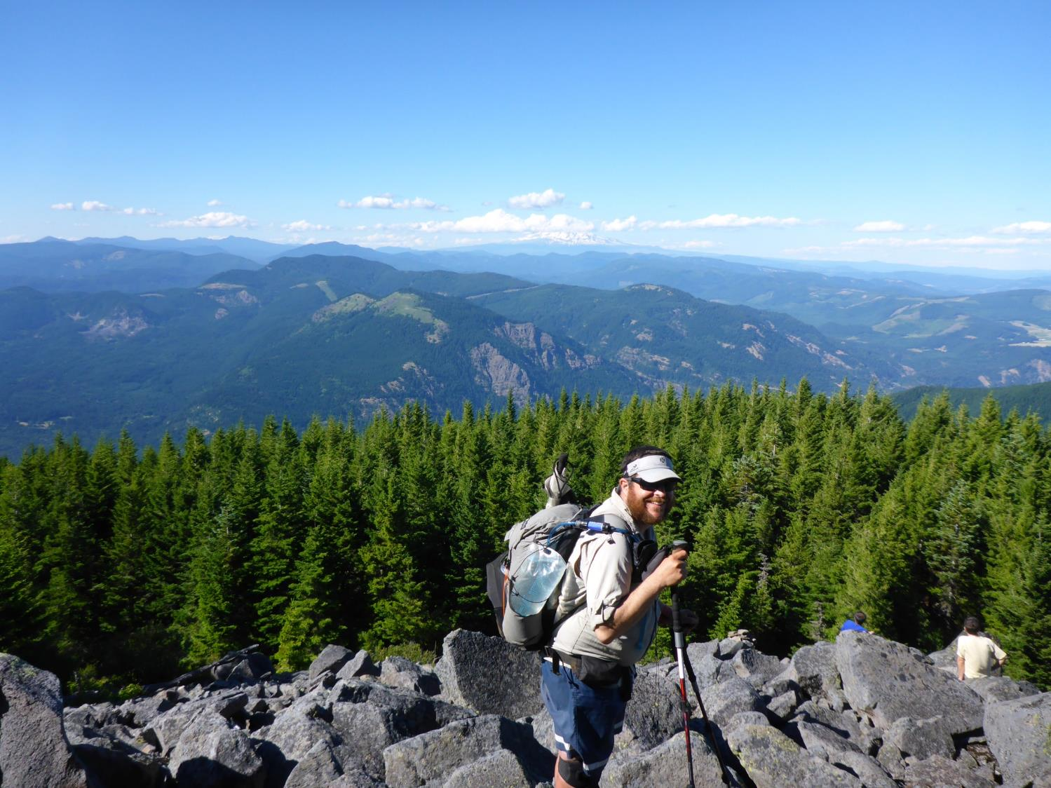

Slide 63
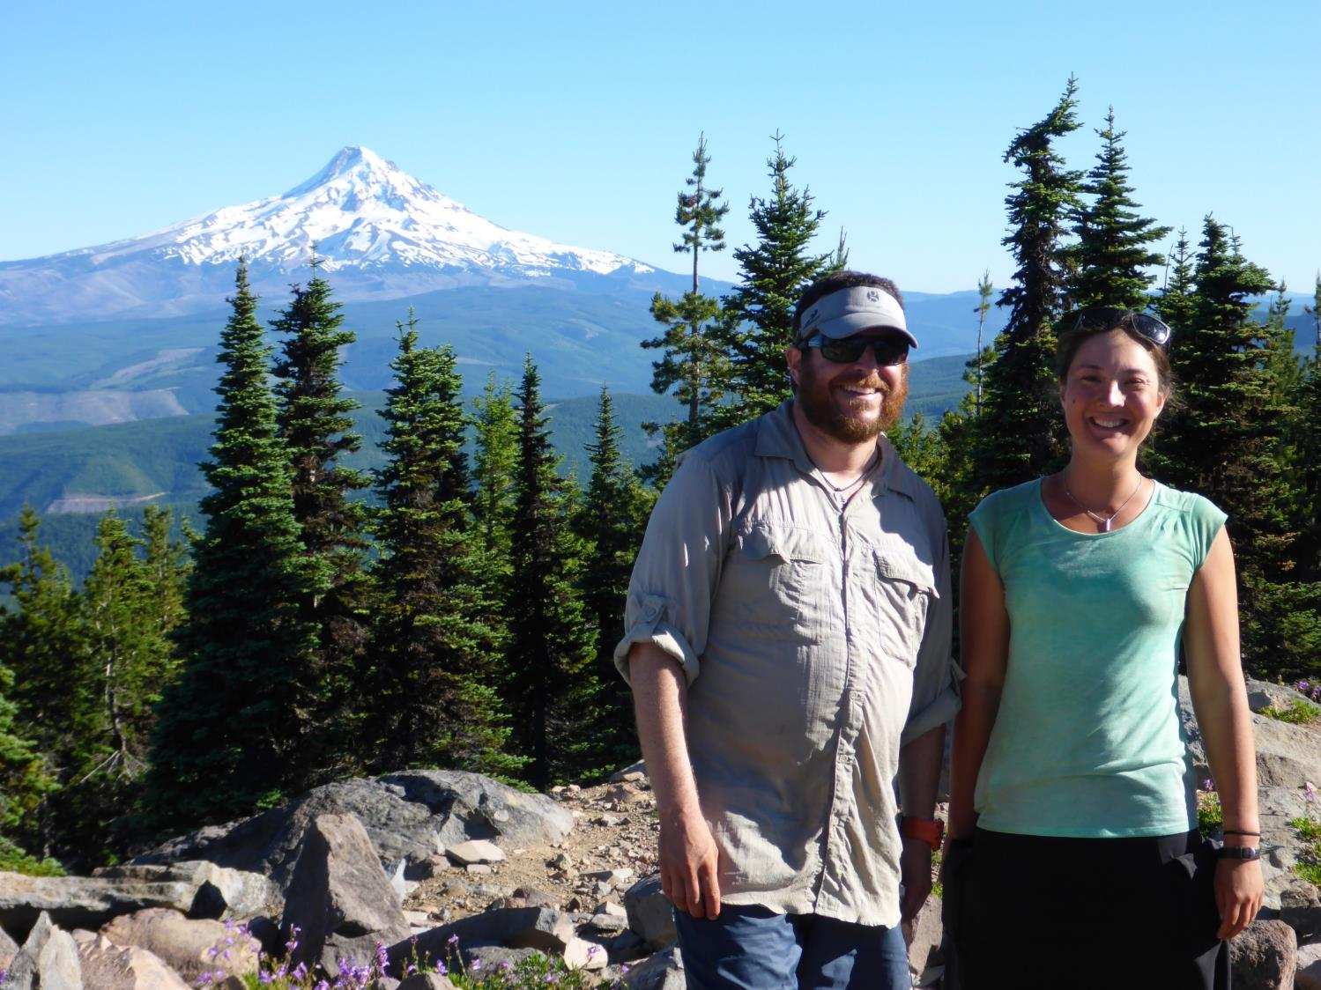

Slide 64
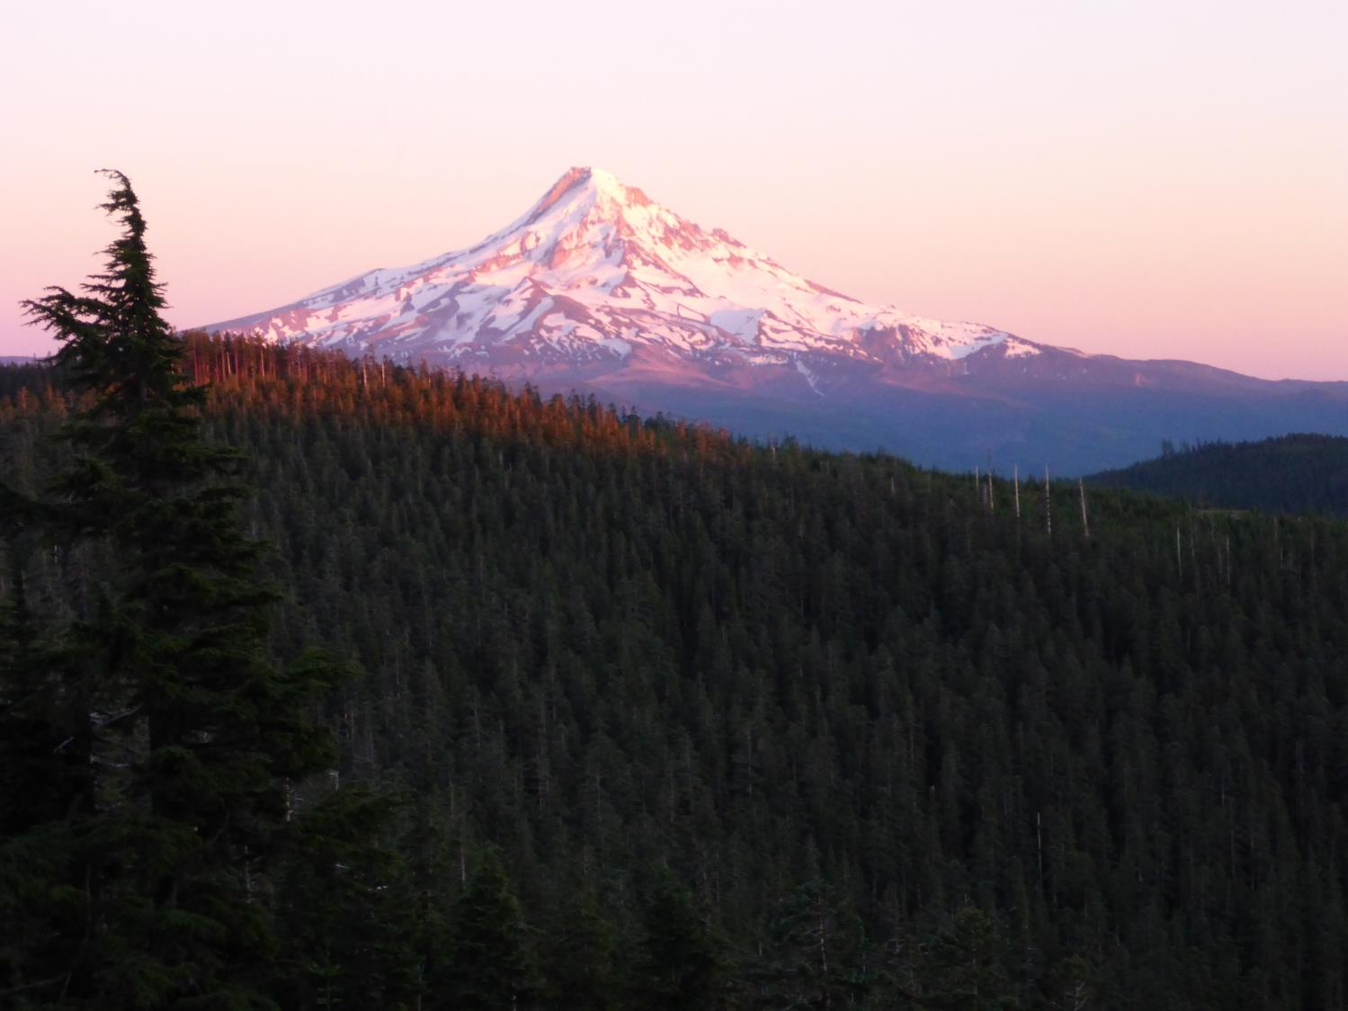

Slide 65
Day 10, July 7
Whatum Lake to Nesmith Point (27 miles)
Trails Used
Eagle Creek Trail No 440
Tanner Butte Trail No 443
Moffet Creek Trail
Up to Nesmith Pt
Weather-still hot
Day had two big climbs, Tanner Butte 1,800’ & Nesmith Pt 2,000’
We were glad to be back in the west and lots of water

Slide 66
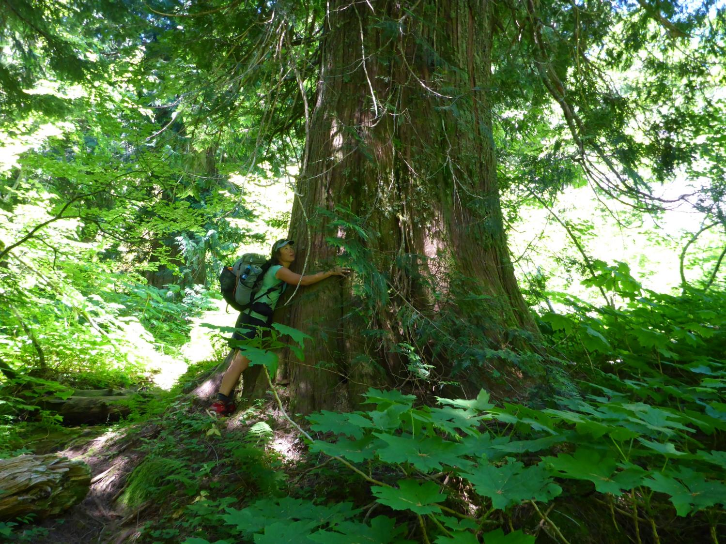

Slide 67
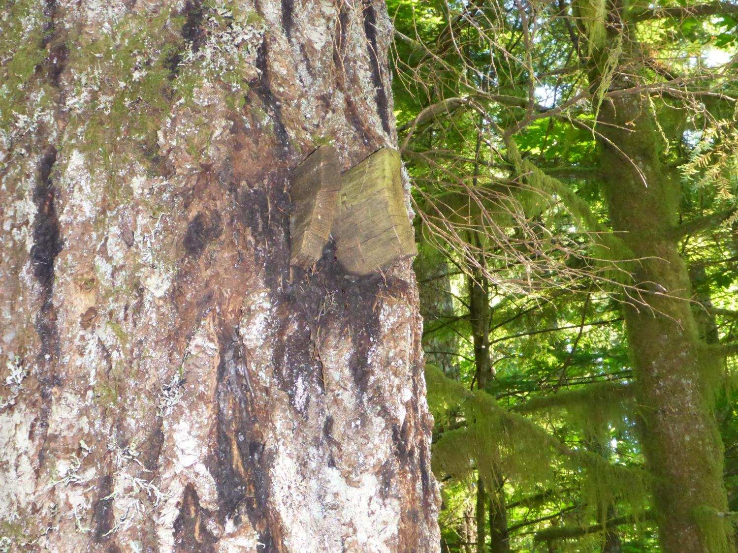

Slide 68
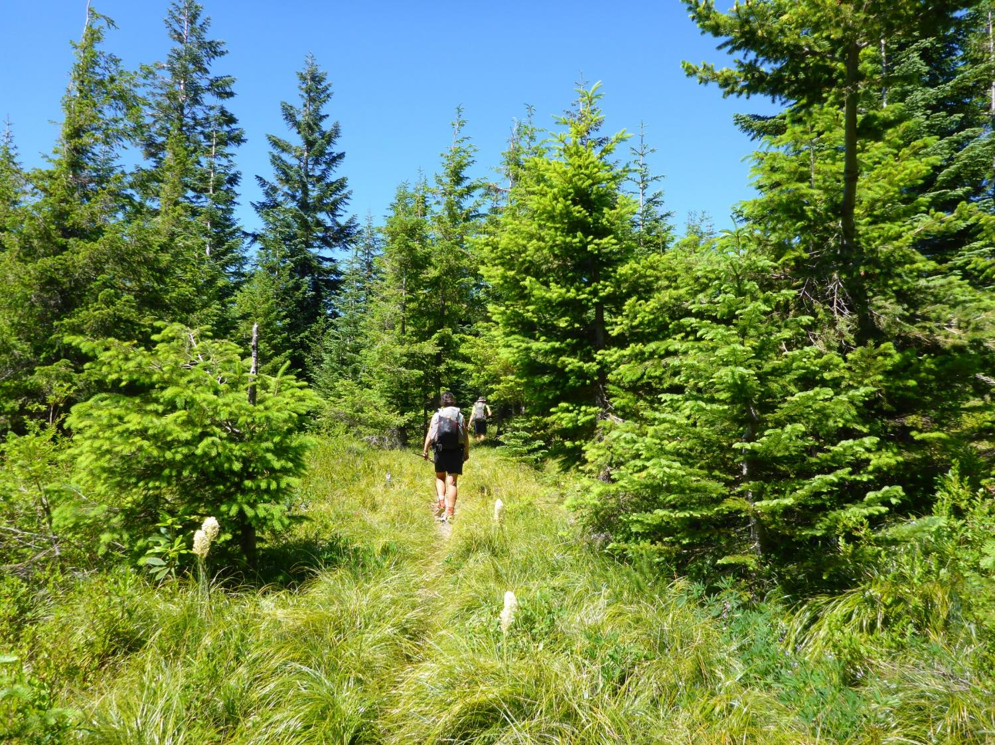

Slide 69
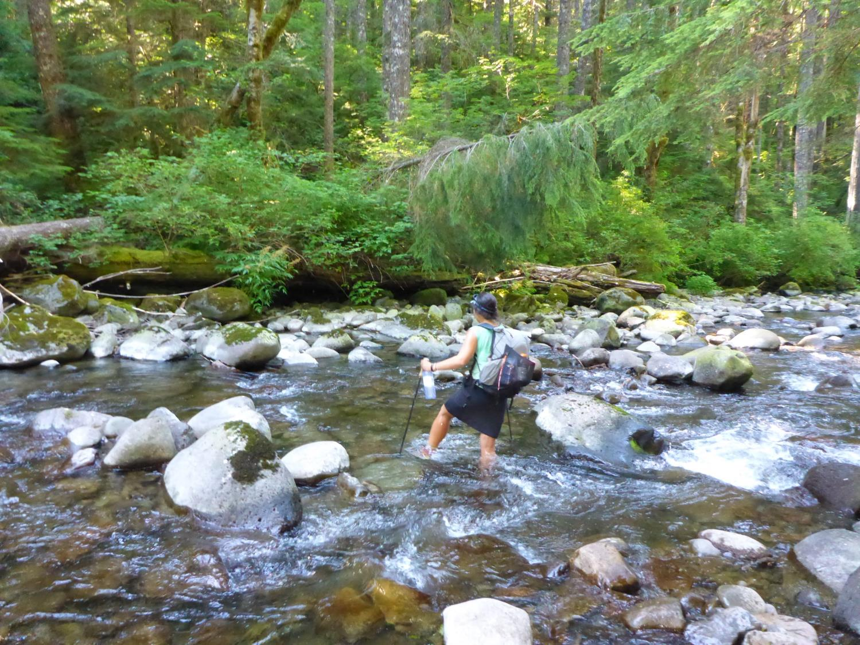

Slide 70
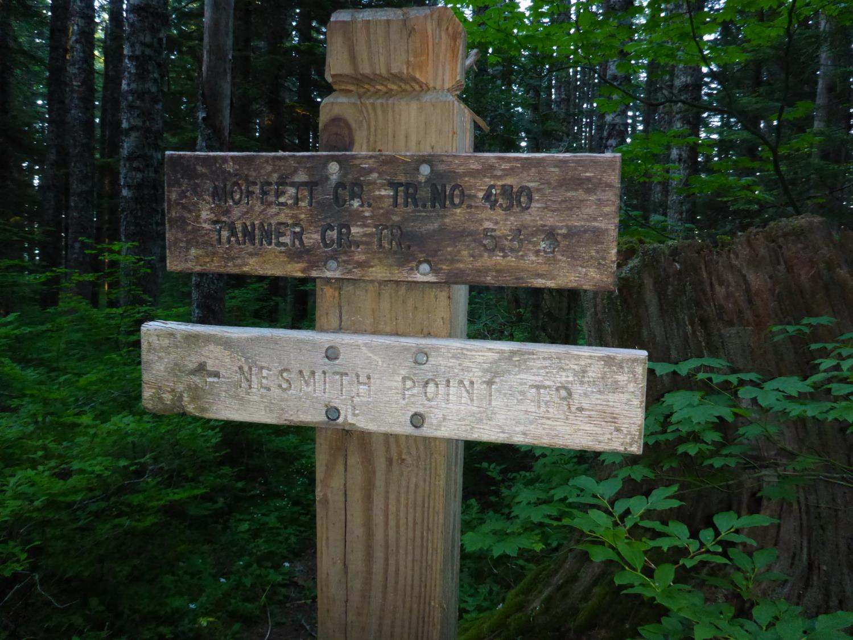

Slide 71
Day 11, July 8
Nesmith Point to Angels Rest TH, Bridal Veil, OR (16 miles)
Trails Used
Bell Creek Trail No 459
Oneonta Trail No 441
Larch Mountain Trail No 441
Trail No 420
Angels Rest Trail No 415
Temp 97 and Humid
Great day we found sandwiches a friend had left us in a tree on trail
Took our time and smelled the roses

